Slide 1
English Constitutional and Legal History:
Regnum and Sacerdotium
Lecture 5
Click here for a printed outline.

Slide 2
Chronology
(There’s a chronology for this lecture on p. III–48 of the Mats., which appears at the head of the printed outline. It won’t fit on a PowerPoint slide, and you might want to have a paper copy of it or have it available on an another device while you are listening to this lecture. Much of what I’ll be saying will be a reaction to Christopher Brooke’s account of these developments which are on pp. III–54 to III–62 of the Mats.)

Slide 3
The traditional view
William I, co-operation between Lanfranc and the king
Henry I, attempts by the papacy to exercise influence thwarted by a strong king
Stephen, papal influence fills a power vacuum
Henry II, attempts to restore the situation to what it was in the time of his grandfather, but was betrayed by Thomas Becket

Slide 4
The problems with the traditional view
The facts are accurate to the extent that we can separate fact from attitude in the traditional account.
It misses the point in much the same way that Henry II missed the point when he attempted to restore the status quo in the time of his grandfather
The issues of the 12th century are not those of the 16th.
We should not speak of church and state in his period but of regnum and sacerdotium or temporal and spiritual.

Slide 5
The reform movement of the eleventh century
Integration of regnum and sacerdotium under a sacral king—the abuses to which this leads
Monastic reform—Cluny, Henry II of Germany (1002–24)
Clerical reform—Leo IX (1049–54), Gregory VII (1073–85): general moral reform, simony, lay investiture, lay ownership of churches, clerical celibacy, primacy of the papacy
The controversy over lay investiture—why it could not be resolved by the modern solution of separation of church and state

Slide 6
The Conqueror and Lanfranc (1070–1089)
Council of London (1075)
Letter to Gregory VII (1073 X 1085, probably earlier in that span)
“To Gregory, the most noble shepherd of the Holy Church, William, by the grace of God renowned king of the English, and duke of the Normans, greeting with amity.”
The document entitled ‘William and the Royal Supremacy’ derived from Eadmer’s History (Mats. p. III–50) may not be genuine.
d. Division of the courts (1066 X 1087, probably later in that span)
“If any one refuses to come to justice before the bishop ... let him be excommunicated; and should there be need to enforce this ban, let the power and justice of the king or of the sheriff be invoked.”

Slide 7
The investiture controversy in England (1097–1107)
It was remarkably short. Contrast the Continent (1075–1122)
Appeals to the papacy were as common in Henry I’s reign as they were in any other place in Europe.
The difference between Lanfranc and Anselm is a difference of generations.

Slide 8
The events of Stephen’s reign
Gratian (c. 1140)
Revival of the study of Roman law
Archbishop Theobald (1138–1161)
Vacarius (?1120–?1200)
John of Salisbury (c.1120–1180
The Cistercians

Slide 9
Gratian’s Concordance of Discordant Canons
“Mankind is ruled by two things, to wit, natural law and customs. Natural law is what is contained in the law and the Gospel in which everyone is ordered to do to another what he wishes to happen to himself and is prohihited from inflicting on another what he does not wish to happen to himself—whence Christ in the Gospel: “Everything that you wish that men do to you, you also do to them, for this is the law and the prophets.” [Matthew 7:12]
“Hence Isidore [of Seville, before 640] says in the fifth book of Etymologies:
“‘All laws are either divine or human, divine laws correspond to nature, human laws to custom’.”

Slide 10
Henry II
The Constitutions of Clarendon (1164)
[c.9] “If a claim is raised by a clergyman against a layman, or by a layman against a clergyman, with regard to any tenement which the clergyman wishes to treat as free alms, but which the layman [wishes to treat] as lay fee, let it, by the consideration of the king’s chief justice and in the presence of the said justice, be settled through the recognition of twelve lawful men whether the tenement belongs to free alms or to lay fee. And if it is recognized as belonging to free alms, the plea shall be [held] in the ecclesiastical court; but if [it is recognized as belonging] to lay fee, unless both call upon the same bishop or [other] baron, the plea shall be [held] in the king’s court. But if, with regard to that fee, both call upon the same bishop or [other] baron, the plea shall be [held] in his court; [yet] so that, on account of the recognition which has been made, he who first was seised [of the land] shall not lose his seisin until proof [of the title] has been made in the plea.”

Slide 11
Henry II — the Constitutions of Clarendon (cont’d)
[c.1] “If controversy arises between laymen, between laymen and clergymen, with regard to advowson and presentation to churches, it shall be treated or concluded in the court of the lord king.”
[c.3] “Clergymen charged and accused of anything shall, on being summoned by a justice of the king, come into his court, to be responsible there for whatever it may seem to the king’s court they should there be responsible for; and [to be responsible] in the ecclesiastical court [for what] it may seem they should there be responsible for—so that the king’s justice shall send into the court of Holy Church to see on what ground matters are there to be treated. And if the clergyman is convicted, or [if he] confesses, the Church should no longer protect him.”

Slide 12
Henry II — the Constitutions of Clarendon (cont’d)
[c.8] “With regard to appeals, should they arise—they should proceed from the archdeacon to the bishop, and from the bishop to the archbishop. And if the archbishop fails to provide justice, recourse should finally be had to the lord king, in order that by his precept the controversy may be brought to an end in the court of the archbishop; so that it should not proceed further without the assent of the lord king.”
[c.15] “Pleas of debt, owed under pledge of faith or without pledge of faith, belong to the king’s justice.”

Slide 13
Henry II — the Becket Controversy
I cannot do justice to the Becket controversy here. The sources are rich, the literature vast, and the leading characters two of the most enigmatic in all history. I must confess, however, that I find many pictures, particularly of Becket, one-sided. (I rather like Brooke’s.) That Becket’s motives were, at times, mixed, that he could be singularly tactless, is certainly true. But tact is not a quality for which martyrs are known. That Henry II had English custom going for him is also true, at least for much of what he was trying to do. But as Becket said to him, quoting Gratian, in one of his less tactful remarks: “Christ did not say ‘I am the custom’; He said ‘I am the truth.’” The controversy brought out the worst in everyone: Becket’s inhumanity, Henry II’s duplicity, the envy of Gilbert Foliot, the bishop of London, a man who otherwise appears in a quite favorable light.

Slide 14
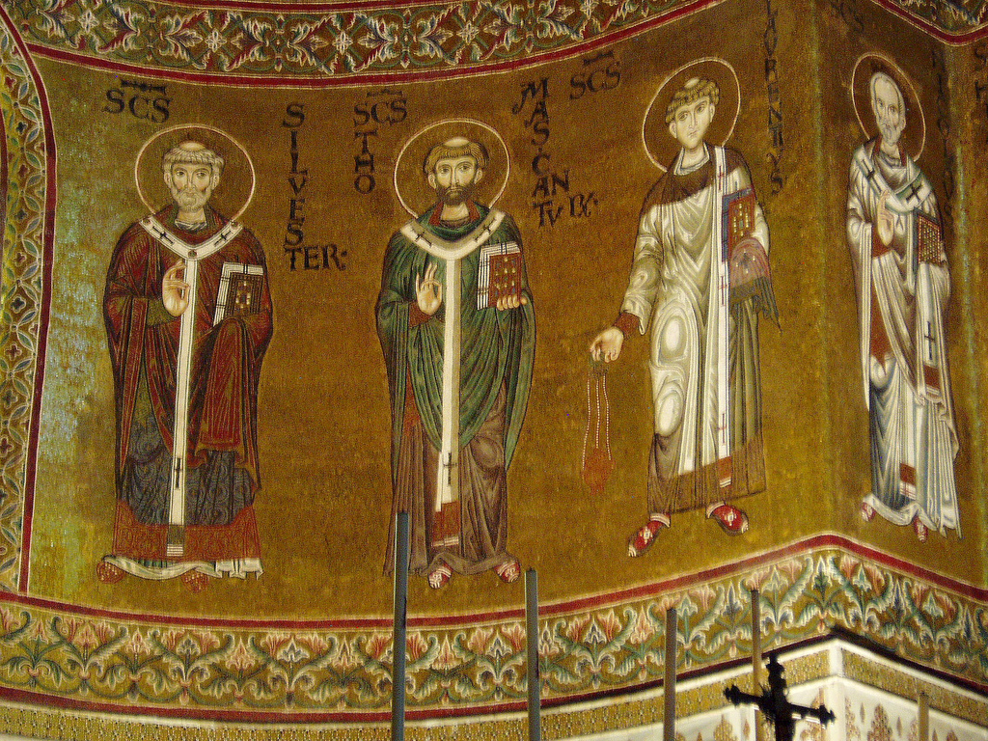
Henry II — the Becket Controversy
Notes:
Cathedral of Monreale, Sicily (1174 X 1181), apse mosaics of martyrs, Thomas of Canterbury is flanked by the Roman martyrs Silvester and Laurence

Slide 15
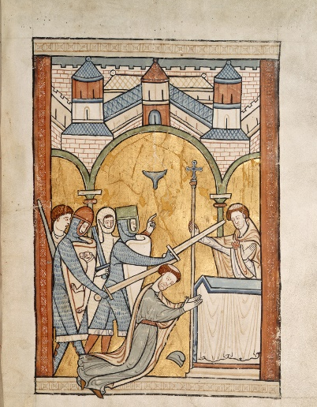
Henry II — the Becket controversy (cont’d)
Notes:
From a psalter of c. 1220, BL, Harley MS 5102, fol. 32

Slide 16
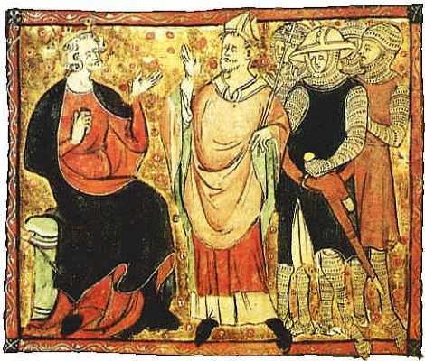
Henry II — the Becket controversy (cont’d)
Notes:
From a manuscript statute book of c. 1312. British Library Cotton MS Claudius D. II, f.73.

Slide 17
Henry II (cont’d)
The compromise of Avranches of 1172—the constitutions of Clarendon are under a cloud; appeals to the pope are allowed; criminous clerks will be punished by the church and not by secular authority, but how the procedure is to work is not settled; nothing is said about advowsons and debts, and much else remains unsettled.

Slide 18
Settlements ultimately reached
The assize utrum, which began as a preliminary inquiry into whether land was held in lay fee or by free alms, became by a process that is still imperfectly undersood, what was called the “parson’s writ of right.” If the clergyman won the case that was the end of it.
Advowsons remained within the jurisdiction of the secular courts, but possessory actions concerning churches were tried in the ecclesiastical courts.
Criminous clerks were tried in the secular courts, but they could then claim their clergy and were turned over the bishop for punishment. The bishop sometimes retried them and set them free. Sometimes he imprisoned them.
Appeals to the papacy from the ecclesiastical courts were common and largely unimpeded until a new set of statutes were passed about the practice in the 14th c.
Lay debts, except those that dealt with marriage or with testaments, were officially matters for the king’s courts. The ecclesiastical courts, in fact, heard a large number of such cases in the 14th and 15th c.

Slide 19
An attempt to summarize at the macro level
An attempt at a “constitutional” document before the time was ripe?
The reason that the west developed the notion of the rule of law?

Slide 20
An attempt to summarize at the micro level
Introduction of bifurcated proceedings (possessory vs. proprietary)?
Jurisdictional division on the basis of substance rather than persons.

Slide 21
Where do we go from here?
In the second half of this class we’ll look at the secular side and at lordship in the treatise known as Glanvill. Next week we’ll do some more with Glanvill and look at some cases that show Glanvill’s treatise in operation, in a series of documents that I call the ‘Polstead saga’. There won’t be any recorded lectures for these materials. The name of the game is not what I get out of these documents but what you get out of them.

