Slide 1
English Constitutional and Legal History: Anglo-Saxon Constitutional History Lecture 2
Click here for a printed outline.

Slide 2
Basic Chronology (Mats. p. II–1)
?450–600 — The invasions to Æthelberht of Kent
600–835 — (A healthy chunk of time here; the same amount of time that the United States has been in existence.) The period of the Heptarchy—overlordships moving from Northumbria to Mercia to Wessex.
835–924 — The Danish Invasions.
924–1066 — The kingdom of England ending with the Norman Conquest.

Slide 3
Sources
Narrative history: Bede (d. 735), Ecclesiastical History of the English People; the Anglo-Saxon Chronicle (late 9th to mid-12th centuries)
The so-called “law codes,” beginning with Æthelberht (c. 600) and going right up through Cnut (d. 1035).
Language and literature: Beowulf, lyric poetry, sermons, saints‘ lives, medical treatises, riddles
Place-names, geographical features that result from human activity
Coins
Art and archaeology
Charters

Slide 4
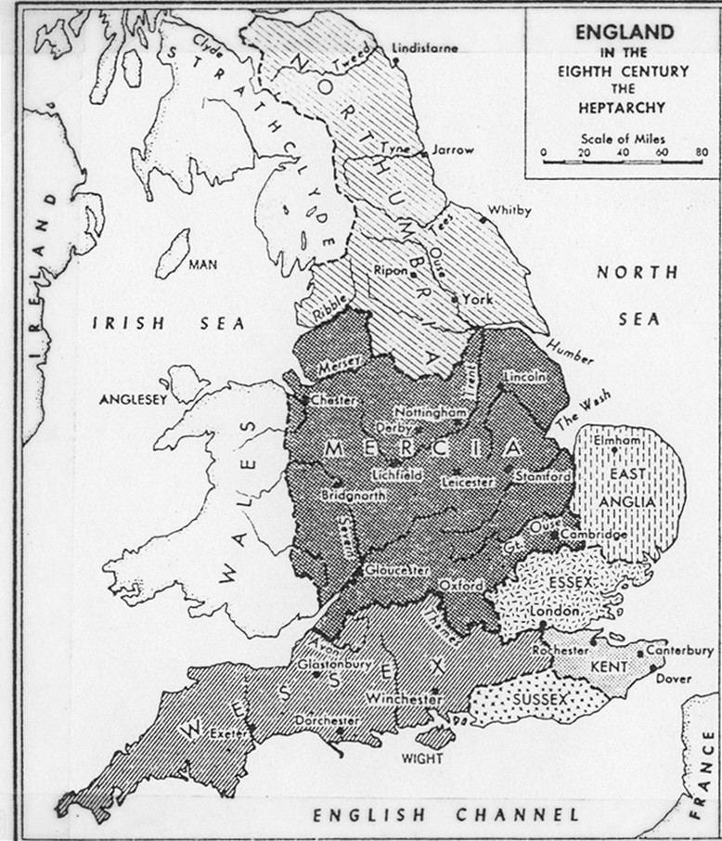
Map of England in the 8th century (Mats. p. II–0)
Pretend that medieval England had a constitution in the modern sense? The danger of anachronism and the mistakes of William Stubbs.
Pretend that medieval England had a constitution in the modern sense? The danger of anachronism and the mistakes of William Stubbs.
Pretend that medieval England had a constitution in the modern sense? The danger of anachronism and the mistakes of William Stubbs.

Slide 5
Basic Chronology (Mats. p. II–1) (again)
?450–600 — The invasions to Æthelberht of Kent
600–835 —The period of the Heptarchy—overlordships moving from Northumbria to Mercia to Wessex. (A healthy chunk of time here; the same amount of time that the United States has been in existence.)
835–924 — The Danish Invasions.
924–1066 — The kingdom of England ending with the Norman Conquest.

Slide 6
Basic chronology problematized
?450–600 — Virtually everything that the narrative sources tell us about the earliest period is mythological
600–835 — The map of the Heptarchy (Slide 4) implies a precision both as to the geographical boundaries and as to the number of kingdoms that is belied by a much more messy reality.
835–924 — The chronology of the Danish Invasions is almost artitrary.
924–1066 — There are arguments for placing the beginning of the kingdom of England as early as the reign of Offa in the late eighth century and as late as King Edgar in 975.

Slide 7
The invasions according to Bede, 450–600 (Mats. p. II–1)
They came from three very powerful nations of the Germans, namely the Saxons, the Angles and the Jutes. From the stock of the Jutes are the people of Kent and the people of Wight, that is, the race which holds the Isle of Wight, and that which in the province of the West Saxons is to this day called the nation of the Jutes, situated opposite that same Isle of Wight. From the Saxons, that is, from the region which now is called that of the Old Saxons, came the East Saxons, the South Saxons, the West Saxons. Further, from the Angles, that is, from the country which is called Angulus and which from that time until today is said to have remained deserted between the provinces of the Jutes and the Saxons, are sprung the East Angles, the Middle Angles, the Mercians, the whole race of the Northumbrians, that is, of those peoples who dwell north of the River Humber, and the other peoples of the Angles. Their first leaders are said to have been two brothers, Hengest and Horsa, of whom Horsa was afterwards killed by the Britons in battle, and has still in the eastern parts of Kent a monument inscribed with his name. They were the sons of Wihtgils, the son of Witta, the son of Wecta, the son of Woden, from whose stock the royal race of many provinces trace their descent.

Slide 8
The invasions according to Bede, 450–600 (cont’d)
The mythological elements in this are clear. The genealogy of Hengest and Horsa goes back four generations to the Germanic god Woden who gave his name to Wednesday, Wotan of the Wagnerian operas. Horsa is not otherwise recorded as a personal name in Old English, and the word means ‘horse’. A pair of brothers associated with horses is found in many Indo-European myths, for example, Castor and Pollux.
Bede gives us the names of what may be tribal groups. There is danger in over-emphasizing the differences. These people almost certainly spoke the same language or languages so close that they were mutually intelligible.
That some can be described as Saxons and some as Angles is generally accepted.

Slide 9
The invasions according to Bede, 450–600 (cont’d)
Much more problematic are the Jutes. There may be a connection here with the Franks. Some have seen it in the agricultural patterns and the inheritance patterns in Kent. Certainly Æthelberht’s wife was a Frankish princess named Berhta. It is unlikely that the name of modern Jutland in Denmark derives from them, though Bede seems to think so.
Procopius, a Byzantine historian writing in the mid–6th c., adds Frisians to the list of invaders — so do the modern linguists. Of all the Germanic languages and dialects spoken in Continental Europe today Frisian is linguistically the closest to English.
The map on the next slide is largely based on Bede, and so wrong in the ways just suggested, by putting the origin of the Jutes where they probably do not belong and missing the Frisians. It also does not follow Bede in putting the Jutes on the Isle of Wight, though no one today is quite sure that Bede meant by that. Like all modern maps of early history, it implies a precision that did not exist.

Slide 10
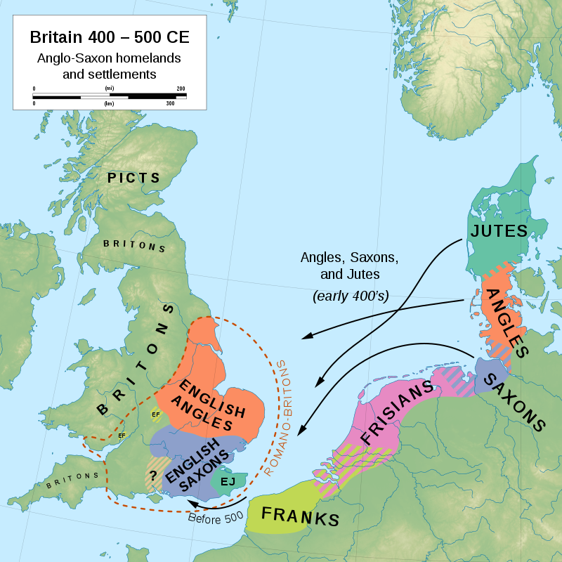
A recent map of the invasions
Notes:
By mbartelsm - Own work, CC BY-SA 3.0, https://commons.wikimedia.org/w/index.php?curid=86531831
Primarily based on Bede's Ecclesiastical History (Book I, Chapter 15), giving Angle, Saxon, and Jute homelands; Jones & Mattingly's Atlas of Roman Britain (ISBN 978-1-84217-06700, 1990, reprinted 2007); and Higham's Rome, Britain and the Anglo-Saxons (ISBN 1-85264-022-7, 1992).

Slide 11
The invaders – why did they come?
iIn the early to mid-fifth century a group of wild men called Huns came off the steppes of Central Asia and pushed various Germanic tribes into the Roman Empire. The explanation of the Anglo-Saxon invasions that relies on the Huns suggests that as various Germanic tribes were pushed into the west those that were living on the south shore of the north sea had no place to go on land, so they got into their boats and went to England..
Beginning in the Netherlands and running all the way to Gdansk the land is very low lying. There is some evidence that in the fourth century the water-level in the North Sea rose. People living along this coast would have been flooded out, so they got into their boats and went to England..
Neither explanation is very satisfactory for the Angles, who would seem to have been living on the west shore of the Baltic and not on the south shore of the north sea. We also know that long before either of these things happened the Germanic peoples were on the move.

Slide 12
The success of the invasions
We should avoid the impression that the invaders simply swept over the land. There were set-backs probably as late as the mid-sixth century. (These may be the source of the Arthurian legends). Place-name evidence suggests, however, that the conquest was relatively complete. Those of the Britons, the Celtic-speaking people who lived in the area at the time, who were not killed and who did not move west to become the ancestors of the modern Welsh and Cornish were probably absorbed. Their genetic contribution to the modern English population seems – emphasize seems – to be quite high.

Slide 13
Map of England in the 8th century (again)
Pretend that medieval England had a constitution in the modern sense? The danger of anachronism and the mistakes of William Stubbs.
Pretend that medieval England had a constitution in the modern sense? The danger of anachronism and the mistakes of William Stubbs.
Pretend that medieval England had a constitution in the modern sense? The danger of anachronism and the mistakes of William Stubbs.

Slide 14
Bede’s account of the conversion of Edwin, king of the Northumbrians, by Paulinus, later bishop of Rochester, in 627 (Mats. p. II–2).
When the king had heard these words [of Paulinus], he replied that he was both willing and bound to receive the faith which he taught. Still, he said that he would confer about it with his loyal chief men and counsellors, so that if they also were of his opinion they might all be consecrated to Christ together in the font of life. And with Paulinus’ assent, he did as he had said. For, holding a council with his wise men, he asked of each in turn what he thought of this doctrine, previously unknown, and of this new worship of God, which was preached.

Slide 15
The conversion of Edwin by Paulinus (cont’d).
The chief of his priests, Coifi, at once replied to him: “See, king, what manner of thing this is which is now preached to us; for I most surely admit to you, what I have learnt beyond a doubt, that the religion which we have held up till now has no power at all and no use. For none of your followers has applied himself to the worship of our gods more zealously than I; and nevertheless there are many who receive from you more ample gifts and greater honours than I, and prosper more in all things which they plan to do or get. But if the gods were of any avail, they would rather help me, who have been careful to serve them more devotedly. It remains, therefore, that if on examination you find these new things, which are now preached to us, better and more efficacious, we should hasten to receive them without any delay.”

Slide 16
The conversion of Edwin by Paulinus (cont’d).
Another of the king’s chief men, assenting to his persuasive and prudent words, immediately added: “Thus, O king, the present life of men on earth, in comparison with that time which is unknown to us, appears to me to be as if, when you are sitting at supper with your ealdormen and thegns in the winter-time, and a fire is lighted in the midst and the hall warmed, but everywhere outside the storms of wintry rain and snow are raging, a sparrow should come and fly rapidly through the hall, coming in at one door, and immediately out at the other. Whilst it is inside, it is not touched by the storm of winter, but yet, that tiny space of calm gone in a moment, from winter at once returning to winter, it is lost to your sight. Thus this life of men appears for a little while; but of what is to follow, or of what went before, we are entirely ignorant. Hence, if this new teaching brings greater certainty, it seems fit to be followed.” The rest of the nobles and king’s counsellors, by divine inspiration, spoke to the same effect.

Slide 17
The conversion of England according to Bede
Pope Gregory I and Augustine of Canterbury (late 6th century)
The role of the Irish; the synod of Whitby (663)
Theodore of Tarsus and the council of Hertford (672)
Benet Biscop and the founding of the monasteries of Monkwearmouth (674) and Jarrow (681)

Slide 18
Constitutional ideas in the story of the conversion of Edwin
“loyal chief men and counsellors” (amicis principibus consiliariis)
“in the council of the wise” (in consilio sapientium)
“earldomen and thegns” (cum ducibus et ministris, literally ‘leaders and ministers’
“nobles and king’s counsellors” (maiores natu, literally ‘those greater by birth’, and regis consiliarii)h century

Slide 19
The bretwaldan
The next passage on the outline (Mats. p. II–3), the one about Æthelberht will play an important role in the next class. Let us focus a word that appears in the middle of the passage: the word that is translated ‘sovereignty’. It’s imperium in the Latin, an important word in Roman constitutional thought, and Bede’s Latin was good. Anglo-Saxon sources describe these men as bretwaldan. Bede’s list of bretwaldan gives the title to Æthelberht of Kent, then to Rædwald of East Anglia, then to Edwin of Northumbria and then to a succession of Northumbrian kings. The next bretwaldan after the Northumbrians are Æthelbald and Offa of Mercia. Bede already notes the ascendancy of Æthelbald at the end of his life. What bretwalda means is complicated. Some sort of ascendancy is clearly being referred to. Precisely what kind of ascendancy may not be recoverable.

Slide 20
The battle of “Brunanburh” — Anglo-Saxon Chronicle a. 937 (Mats. p. II–2)
Hēr Æþelstān cyning, eorla dryhten,
beorna bēahgifa, ond his brōþor ēac,
Ēadmund æþeling, ealdorlangne tīr
geslōgon æt sæcce sweorda ecgum
ymbe Brūnanburh. Bordweal clufan,
hēowan heaþolinde hamora lāfan
afaran Ēadweardes, swā him geæþele wæs
from cnēomæ¯gum, þæt hī æt campe oft
wiþ lāþra gehwæne land ealgodon
hord ond hāmas.
In this year King Æthelstan, lord of earls / ring-giver of warriors, and his brother also, / Edmund atheling, undying glory / won by sword’s edge in battle / around “Brunanburh.” Shield-wall they cleaved, / hewed war-linden [linden bucklers] with hammers’ leavings [hammered blades], / offspring of Edward, as was inborn to them / from their ancestry, that they at battle oft / with each enemy defend their land, / hoard and homes.

Slide 21
The battle of “Brunanburh” (cont’d)
Hēr : ‘here’, cyning : ‘king’, eorla : ‘earl’, gifa in bēahgifa : ‘give’, ond his brōþor ēac ‘and his brother eke’, sweorda ecgum : ‘swords’ edges’, ond : ‘and’, his : ‘his’, æt : ‘at’, wæs : ‘was’, from : ‘from’, þæt: ‘that’, wiþ : ‘with’.
Germanic heroic verse
cyning, the son of the kin—eorla dryhten, lord of earls—beorna beahgifa, ring-giver of warriors—ætheling, son of the nobility
The year is 937, and the poem is describing a battle against the Norse and the Scots at a place, on the n.w. coast of England, though we’re not sure quite where ‘Brunanburh’ was. The story of what happened between eighth and the tenth centuries has a plot somewhat like an heroic poem

Slide 22
Establishment of the kingdom of England — 716—899
The eighth century is the period to ascendancy of Mercia, a kingdom in the north middle part of England. Æthelbald 716–757, whom Bede mentions, and Offa 757–796, who calls himself rex totius Anglie patrie (king of the whole fatherland of England). The other kings are subreguli ‘underkings’.
In 802, Egbert, way out of the line of succession, became king of the West Saxons. In 825, he defeated the Mercians at Ellendum. From there on the leading king in England was the king of the West Saxons.
But the West Saxons had a new and dangerous enemy to face. In 835, the Vikings who had been raiding England since the early part of the century launched a major invasion. In 865 the mickel here (‘big army’) arrived and spent the winter. They began a conquest that threatened to take over the whole of England.
But their progress was stopped by Alfred 871–899, the greatest of the Anglo-Saxon kings; he contained the Danes in the Danelaw, and launched a massive revival of Anglo-Saxon culture.

Slide 23
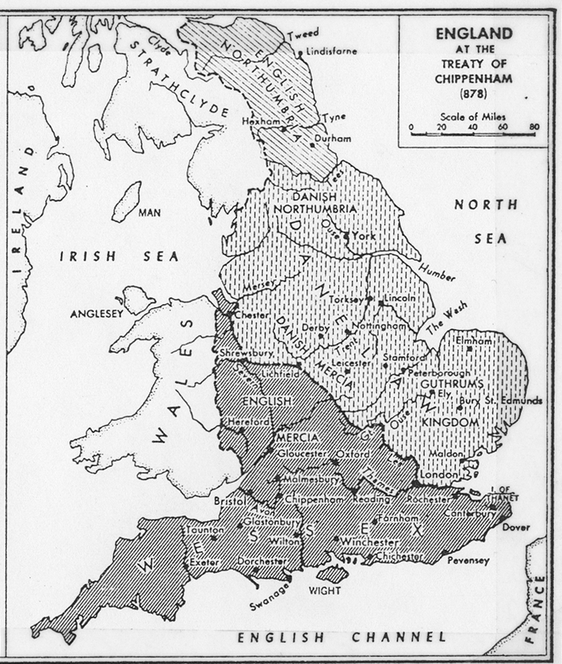
The Danelaw in 878

Slide 24
The penetration of the Danes
Another way to get some sense of how important an element that the Danes are is in the line of the poem: “afaran Ēadweardes, swā him geæþele wæs from cnēomæ¯gum, þæt hī æt campe oft” (“offspring of Edward as was inborn in them from their ancestry, that they at battle oft”). “Him” and “hi” are our words “them” and “they,” and the reason why it is “them” and they rather than “hem” and “he” (which Chaucer still says) is because of Danish influence in the language. That’s pretty basic. When you change a very common pronoun because of the way that a given group pronounces it, that group is large and has penetrated very deeply into the society.
Closer to our principal concerns, the modern English word ‘law’ is a Danish word. The Anglo-Saxons had a number of words for ‘law’, but the ancestor of our word ‘law’ was not one of them.

Slide 25
Establishment of the kingdom of England — 899–1066
Alfred’s son, Edward the Elder (899–924), with his sister Æthelflæd, reconquered the Danelaw to the Humber. There was a great religious revival under Dunstan.
During the reigns of Æthelstan of the poem (924–39) and Edmund of the poem (939–46), the north of England was recovered, then lost, then recovered again.
Edgar, known as the peaceable, became king of all England (957–975) – major coronation ceremony at the end of his reign.

Slide 26
The coronation oath of Edgar (973) (Mats. p. II–3).
This writing has been copied, letter by letter, from the writing which Archbishop Dunstan gave our lord at Kingston on the day that he was consecrated as king, forbidding him to make any promise save this, which at the bishop’s bidding he laid on Christ’s altar:—
In the name of the Holy Trinity, I promise three things to the Christian people of my subjects: first that God’s Church and all Christian people of my realm shall enjoy true peace; second, that I forbid to all ranks of men robbery and wrongful deeds; third that I urge and command justice and mercy in all judgments, so that the gracious and compassionate God who lives and reigns may grant us all His everlasting mercy.

Slide 27
Establishment of the kingdom of England — 899–1066 (cont’d)
Unfortunately, the next major king was Æthelred the Unready (means he didn't take counsel), 978–1016, who had a long and disastrous reign.
He was succeeded by Cnut (1016–1035), a Danish king, but this was a different kind of Danish invasion. Cnut was a Christian. He governed a North Sea empire that included Denmark, and he ruled in England through native Anglo-Saxons and native Danes.
The native Anglo-Saxon dynasty returned with Edward the Confessor, son of Æthelred the Unready. Edward began to reign in 1042 and died childless on 5 Jan. 1066. But that is a story for next week.
After class discussion of the lecture, we’ll look at some images. There’s a list of the images on the outline with links.

