Slide 1
English Constitutional and Legal History: Parliament Lecture 10
Click here for a printed outline.

Slide 2
The topic of the lecture
The point of this lecture is that the development of parliament was gradual, and that much of the historiography is anachronistic. Since I’m going to try to date things in later reigns, we need to have in mind the dates of a couple of kings to whom we have not yet officially come. Edward I, as you will recall, reigned from 1272–1307. He was succeded by his eldest son, Edward II, who reigned from 1307–1327, who was succeeded by his eldest son, Edward III who reigned from 1327–1377, 50 years, the longest reign of any English monarch until George III beat him by 10 years, 1760–1820.

Slide 3
Various defintions of ‘parliament’
Parliament is a typically medieval institution but one the importance of which can be exaggerated.
The word ‘parliament’ is derived from French parler, which means ‘to speak’. This was then converted into Latin parliamentum. Leave to imparl in law implies that the parties are seeking a compromise. Colloquium, literally ‘talking together, in Latin is only gradually replaced by parliamentum. To translate parliament as “gab-fest” is perhaps too colloquial, but it gets the idea. In the late 14th century Chaucer writes a poem called the “parliament of birds” in which there is only a slight hint that he’s thinking of the contemporary institution and not the original meaning of the word.

Slide 4
Various defintions of ‘parliament’ (cont’d)
Depending on how we define the institution, we can say:
Parliament was ‘foreshadowed’ in Simon de Montfort’s parliament of 1265 and the first ‘real’ parliament was the model parliament of 1295, because both of these have king, prelates, barons, knights of shire and burgesses of the boroughs, the constituent elements of the lords and commons of Stubbs’ time.
If we are seeking a body with a well-defined class of records, a fixed procedure and sphere of competence ‘parliament’ does not exist until the reign of Edward III (1327–1377).
If we are seeking a body in which sovereignty rests, we must wait until the Long Parliament following the execution of Charles I in the 17th century (1649), and in a very real sense the modern institution has a continuous history dating back only to the 18th century.

Slide 5
Questions to be addressed:
When did the word ‘parliament’ acquire a precise meaning for contemporaries, however far this meaning may be from our own? In short, and somewhat anachronistically, when do see a change from “a” parliament to “the” parliament?
Who was normally at these gatherings? Who must be at these gatherings?
What was normally treated at these gatherings? What must be treated at these gatherings?
What is the underlying theory, express or implied, of the nature of this body?

Slide 6
Various defintions of ‘parliament’ (cont’d)
When did the word acquire a precise meaning for contemporaries, however far this meaning may be from our own?—in the last decades of the reign of Henry III. This is when the court coram rege and the council began to adjourn cases “to the next parliament.” “The king”, Fleta (c. 1300) says, “has his court in his council in his parliaments, when prelates, earls, barons, magnates and others learned in the law are present. And doubts are determined there regarding judgments, new remedies are devised for wrongs newly brought to light and there also justice is dispensed to everyone according to his deserts.”

Slide 7
Who was normally at these gatherings? (taking the 50 parliaments of Edward I)
The king—only very occasionally by representative
The aristocratic element, earls, barons, archbishops., bishops, abbots—no hereditary right (probably happened temp. Edward II)
Ministers—“do not gloss the statute; for we made it.” C.J. Hengham in 1305.
Shire knights in 14, burgesses in 11, lower clergy in about 6 (the uncertainty about the lower clergy in the later Middle Ages)

Slide 8
The idea of representation, Mats., p. V-34 to V-36:
[The first parliament of 1295:] “Edward, [by the grace of God king of England,] etc., to the venerable father in Christ, R[obert Winchelsey], by the same grace archbishop of Canterbury and primate of all England, greeting. Whereas, with regard to certain arduous affairs touching us and our kingdom, as well as you and the other prelates of the same kingdom, which we are unwilling to settle without your presence and theirs, we wish to hold our parliament and to have a conference and discussion with you concerning these matters, we command and firmly enjoin you, in the fealty and love by which you are bound to us, to come to us at Westminster on the first day of the month of August next, or in any case within the third day following at the latest, in order with us to consider the said affairs and to give us your counsel. And by no means fail to do this. By my own witness at Whitchurch, June 24. By writ of the privy seal.”

Slide 9
The idea of representation (cont’d)
This Parliament met in August. Because no knights or burgesses were summoned, Stubbs called it a ‘Great Council’, but all the official records call it a parliament. It discussed the possibility of truce with France and dealt with some important judicial business. It may also have discussed the necessity for extraordinary taxation in order to prepare for war with France, because shortly thereafter (at the end of September) writs of summons were issued to what Stubbs called the “Model Parliament” of 1295, which was held later in the year.

Slide 10
The idea of representation (cont’d)
[The second parliament of 1295:] “The king to the venerable father in Christ, R[obert], by the same grace archbishop of Canterbury and primate of all England. As the most just law, established by the foresighted wisdom of the holy princes, urges and lays down that what touches all should be approved by all (quod omnes tangit debet ab omnibus approbari), so it is plainly apparent that common dangers should be removed by remedies provided in common. Surely you know sufficiently [for] it is already made public throughout all the regions of the world how the king of France fraudulently and deceitfully deprived us of our land of Gascony, wickedly detaining it from us. Now, however, not content with the aforesaid fraud and wickedness, he has gathered together a large fleet and a copious multitude of warriors to attack our kingdom, with which he has already hostilely invaded our kingdom and the inhabitants of our kingdom, proposing – if he has the power to correspond to the detestable proposal of the iniquity he has conceieved – to wipe out –which God forbid! – the English language from the face of the earth. [cont’d on next slide]

Slide 11
The idea of representation (cont’d)
Wherefore, since darts cause less injury when they are foreseen, and since your fortunes, like those of the other citizens of the same kingdom, are greatly concerned in this affair, we command and firmly enjoin you, in the fealty and love by which you are bound to us, that on Sunday next after the feast of St. Martin in the coming winter [the feast is 17 November] you personally be present at Westminster; first summoning (premunientes) the prior and chapter of your church and the archdeacons and all the clergy of your diocese, the said prior and archdeacons to be present along with you in person, the said chapter [to be represented] by one fit proctor, and the said clergy by two-which proctors are to have full and sufficient authority (plenam et sufficientem potestatem) from the said chapter and clergy to concern themselves, together with us, with the rest of the prelates and magnates, and with other inhabitants of our kingdom in considering, ordaining, and deciding how such dangers and premeditated evils are to be obviated. By witness of the king, at Wingham, September 30.”

Slide 12
The idea of representation (cont’d)
[The second parliament of 1295:] “The king to the sheriff of Northampton, greeting. Whereas we wish to have a conference and discussion with the earls, barons, and other nobles of our realm concerning the provision of remedies for the dangers that in these days threaten the same kingdom – on which account we have ordered them to come to us at Westminster on the Sunday next after the feast of St. Martin in the coming winter, there to consider, ordain, and do whatever the avoidance of such dangers may demand – we command and firmly enjoin you that without delay you cause two knights, of the more discreet and more capable of labour, to be elected from the aforesaid county, and two citizens from each city of the aforesaid county, and two burgesses from each borough, and that you have them come to us on the day and at the place aforesaid; so that the said knights shall then and there have full and sufficient authority (plenam et sufficientem potestatem) on behalf of themselves and the community of the county aforesaid, and the said citizens and burgesses on behalf of themselves and the respective communities of the cities and boroughs aforesaid, to do whatever in the aforesaid matters may be ordained by common counsel; and so that, through default of such authority the aforesaid business shall by no means remain unfinished. [cont’d]

Slide 13
The idea of representation (cont’d)
And you are there to have the names of the knights, citizens, and burgesses, together with this writ. By witness of the king, at Canterbury, October 3.”
So far as the Latin tag quod omnes tangit debet ab omnibus approprobari is concerned S&M say: ‘The rhetorical preamble includes the famous phrase that “what concerns all should be approved by all,” but it is doubtful whether such flourishes had any constitutional significance’. We’ll have occasion later to ask whether that is true or even what S&M’s remark might mean. What is different about the writs to the August parliament and those for the Parliament that eventually met in November is the notion of representation. That the writ to Robert Winchelsey for the August parliament does not contain anything suggesting representation is clear enough. He wasn’t supposed to send a representative, he was supposed to come himself. The same is true of the part of the summons that concerns him personally sent later in the year. But he is also to summon the clergy of the diocese and they aren’t all supposed to come, they are to send representatives. {cont’d on next slide)

Slide 14
The idea of representation (cont’d)
Similarly, the sheriff is not supposed to get every knight in the shire and every citizen and burgess; they are to send representatives. These representatives are to have “full and sufficient authority” plena et sufficiens potestas to bind their principals. The idea of calling representatives antedates parliament. The purpose of calling representatives is basically financial, to get them to consent to extraordinary taxtion. Representatives can meet in or out of parliament and parliament can meet without them. Unless you’re going to define parliament as having to have representatives as a necessary condition, they are not part of the original concept.

Slide 15
Who must be at these gatherings?
the king must be there
some barons and higher clergy must be there
ministers will be there
others may be there.

Slide 16
What was normally treated at these gatherings?
Petitions, Mats., p. V-39 to V-40 (cf. Mats., pp. V–66 to V–67)
In 1275 Parliament began as a regular matter to receive bills or petitions. A bill or a petition is more informal than a writ; it can break out of the quite rigid categories of writs. Bills or petitions simply flooded in. The rolls of parliament begin in earnest in 1285; a clerk of parliament dates from about the same period. The procedure in parliament is best determined from the Memoranda de parliamento of 1305 of which an example is given on p. V–39 to V–40 of the Mats. The parliament rolls from the 1280s that are extracted in your materials on pp. V–66 to V–67 (S&M no. 54(G) is not as detailed, but they certainly suggest that the procedure was basically the same. One or more men were designated as ‘receivers’ of petitions and one or more men as triers of petitions. These latter determined what would happen to the petition. Some went back to Parliament, but very few. Some went to administrative bodies, the Exchequer, the Chancery, the justices, some to a committee of the council, some to the king himself. Thus, parliament was doing its work in committees.

Slide 17
What was normally treated at these gatherings? (cont’d)
To our lord the king Adam Kereseye and Joan, his wife, show that when they impleaded Sir John de Ferrers and Avis, his wife, of the manor of Alnescote before Sir Ralph de Hengham [CJCB, 1301–9) and his companions of which Henry de La Mare, cousin of the said Joan whose heir she is, died seised in his demesne as of fee, and the said John and Avis pleading said that our lord the King, who now is, gave the manor aforesaid to Sir Robert Muscegros and his heirs and that they are seised [of it] as of right and heritage [of] the said Avis, daughter and heir of the said Robert, and they showed a charter of our lord the King about it and said that they could not reply without him, for which the parties went quit without day. Wherefore they pray the lord our King, if it pleases him, that the justices proceed in the plea according to the law and usage of the realm notwithstanding the aforesaid charter such that their right not be further delayed nor the said Joan disinherited. [Dorse, in Latin:] If the charter contains a warranty let them supersede, if not, let them proceed and thus let it be commanded to the justices by a writ from the Chancery. // Copied. // Caen [the receiver] // Enrolled.

Slide 18
Petitions (Mats., p. V-39 to V-40) (cont’d)
The problem here is clear enough. John and Avis have a charter which shows that they can pray aid of the person who granted the charter. That person is the king. The justices can’t order the king to show up; he’s their boss. So the only thing that Adam and Joan can do is to petition the king to allow the justices to proceed. The triers decide, perhaps they consulted with the king about the matter, perhaps they decided it on their own, that if the king warranted the charter, that’s the end of the story. If he did not, the justices may proceed. We had a paper on this case a couple of years ago. It turns out to be quite a bit more complicated than what we see here, but this is the piece that we see.

Slide 19
What was normally treated at these gatherings? (cont’d)
Statutes. Some are made in Parliament, eg Gloucester (1278) (V–27), De donis (1285), Quia emptores (1290); some are not, eg Mortmain (1279) (V–29), Wales (VII–7).
Taxation. It certainly can take place outside of Parliament, but frequently it takes place there. Again its not until the fourteenth century that it is established as a regular matter that extraordinary taxation must take place in parliament.

Slide 20
What must be treated at these gatherings?
Nothing, but early in Edward I’s reign the notion is emerging that petitions will be. Receivers were not appointed in 1332 and an outcry arose, but by that time the judicial functions of Parliament were already declining.
By the beginning of Edward III’s reign the notion is beginning to emerge that to call a piece of legislation a statute it needs to have been made in parliament.
By the beginning of Edward III’s reign the idea is emerging that extraordinary taxation must be treated in parliament.

Slide 21
What is the underlying theory, express or implied, of the nature of this body?
Certainly the notion of consultation with the tenants in chief lies at the root.
Roman and canon law ideas, quod omnes tangit, universitas, plena potestas.
status—state (government, health), community of the realm, estates

Slide 22
What is the underlying theory? (cont’d)
Let me say a few words about this latter group of ideas. Some in an earlier generation of historians, of which S&M are examples, questioned how important these ideas were in the period. I think most people would agree today that they were important as ideas, so that those who question their importance today would question not their existence as ideas but whether ideas play any role in the development of political institutions.
Medieval life was characterized by group activity. Parishes, guilds, vills, schools, cities, religious houses — there were a bewildering variety of medieval groups. In the 13th century a Roman law legal term, universitas, which can be roughly translated “corporation”, came to be applied to at least a number of them. It has been argued that the first was the university of Paris in the early years of the 13th century, though some would argue that it came earlier with religious houses and cathedral chapters. These groups came to have many aspects of legal personality. They could sue and be sued, they could own property, they could bind their members with regulations, they could appoint agents for the transaction of business.

Slide 23
What is the underlying theory? (cont’d)
By the middle of the 13th century in every country of Europe, perhaps earlier in some places, it had come to be recognized that a group could be bound by acts taken in an assembly if the group sent to it a proctor or agent with full power, plena potestas, to bind the group. The phrase is found in the summonses to the English parliament in the time of Edward I. It is found in the summonses to Spanish cortes by the middle of the 13th century. The popes seem to have been using it in the papal states fairly early in the 13th century.
But the idea of consent does follow. It is summed up in the phrase Quod omnes tangit debet ab omnibus approbari, a phrase torn out of context in the Digest was made to apply to things to which it never applied in Roman law. By the end of the 13th century it was still not completely clear what approbari meant. In many matters, such as peace and war, it came to mean simply that consultation should take place. In other matters, however, and in England, France, and Spain, extrordinary taxation was among them, full consent was required, though, of course, considerable pressure could be applied to get that consent.

Slide 24
What is the underlying theory? (cont’d)
Finally, there was another idea, perhaps the vaguest of all, that serves to round it out. What are those matters that concern all? Well, they are those that concern the state of the realm (status regni) or the state of the king (status regis). No word is more chameleon-like than that word ‘state’. Today, of course, it is an abstraction meaning government, and one occasionally finds it in that meaning in the M.A. I wouldn’t use the modern word, however, in this context, because it can too easily get confused with the early modern and modern notion of the nation-state, which does not emerge until the sixteenth century. But ‘state’ in modern English also means those things that deeply affect the person, as in the state of my health. The thirteenth-century English status is the community of the realm. The community of the realm is itself a vast corporation, composed of many smaller corporations, the largest of which are the estates (which is also status in Latin) of the realm.

Slide 25
What is the underlying theory? (cont’d)
Now what are the estates of the realm in this sense? By the early 14th century in England there seem to be at least three: the lords spiritual, the lords temporal, and the commons. Perhaps by the early 14th century in France we can also speak of 3 estates, the nobles, the clergy, and the citizens of the towns. Similar ideas are at least nascent in Spain. There seem to be three estates in the Castillian cortes, nobles, clergy and towns; four in the Aragonese cortes, nobles, knights, clergy and towns.
The vision of government is becoming wider in 13th c. England than it was in the 12th. The barons are already speaking of universitas in 1258. Consultation with community representatives goes back to 1213 at least, and it is frequently connected with taxation. In one sense the judicial is first element of governance that takes this wider view because it was what was first to break free of the feudal world.

Slide 26
What is the overarcing theory?
England in 1300 is a monarchy not a democracy, but the notions of consultation and representation have made it a very different kind of monarchy from what it was under Henry II, and in the development of those notions parliament played an important role and was to play an even more important one later on.
Aristotle came up with three ideal types of government, monarchy, aristocracy, and polity. The last being a kind of constitutional democracy. Each of these forms has a corruption, tyranny (we might call it autarchy), oligarchy, and democracy. Trying to fit England of 1300 into these categories is difficult, because Aristotle assumes that there is a state which can be governed in one of these ways.We can’t make that assumption for the England of 1300 any more than we can make it for the England of 1000 or 1066 or 1189. What we can say is the mixture of monarchy and aristocracy, to use Aristotle’s terms, is becoming somewhat better defined than it was previously. As one of the causes we might point to is that fact that the great economic expansion of the 12th century made it possible for government to do more, just as it made possible the building of the great Romanesque and Gothic cathedrals.

Slide 27
What is the overarching theory? (cont’d)
There is certainly some political theory in the MA. By the end of the 13th century there were those who knew Aristotle’s Politics. That does not mean that everybody knew the Politics or that those who did necessarily applied that work to what was going on around them. Perhaps another way to get at what people thought is by looking at images.

Slide 28
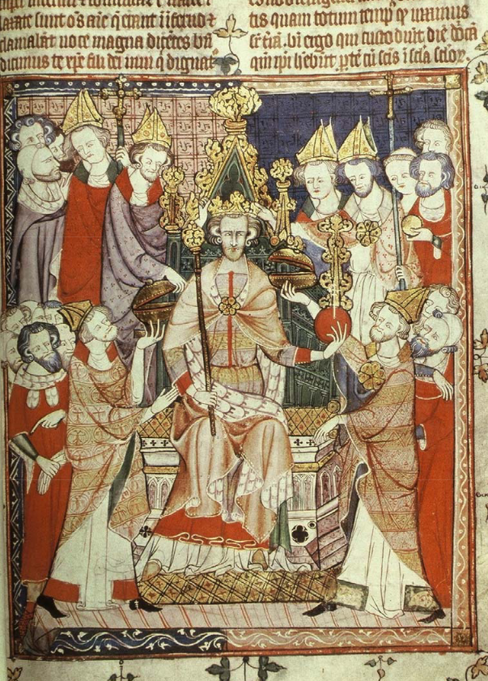

Slide 29
What is the overarching theory? (the Parker ms)
This king/Christ image can be dated to 1329 X 1339. It is from one of the Parker manuscripts in Christ Church College Cambridge, the principal text in which is the New Testament book of Revelation. It is not found in Revelation, however, but is, rather, the frontispiece of liturgical instructions which follow the image about how to conduct a coronation ceremony. This is an image of an idealized king, made to look like Christ enthroned in majesty. There is, however, something about Christian belief about Christ that can be used in political theory. Christians believe that Christ was both God and man. The man was mortal; God is not. The same idea can be found in more mundane contexts. In the early 1170s Alexander III issued a decretal letter in which he said that when he had commissioned the abbot of Lilleshall in Shropshire to hear a case, it was appropriate, when the abbot whom he had commissioned died, for his successor to hear the case. The canonists got out of this decretal a principle: dignitas non moritur, the office does not die. Separating the office, in some sense, from the person who holds it is going to be a key element in medieval and early modern political theory.

Slide 30
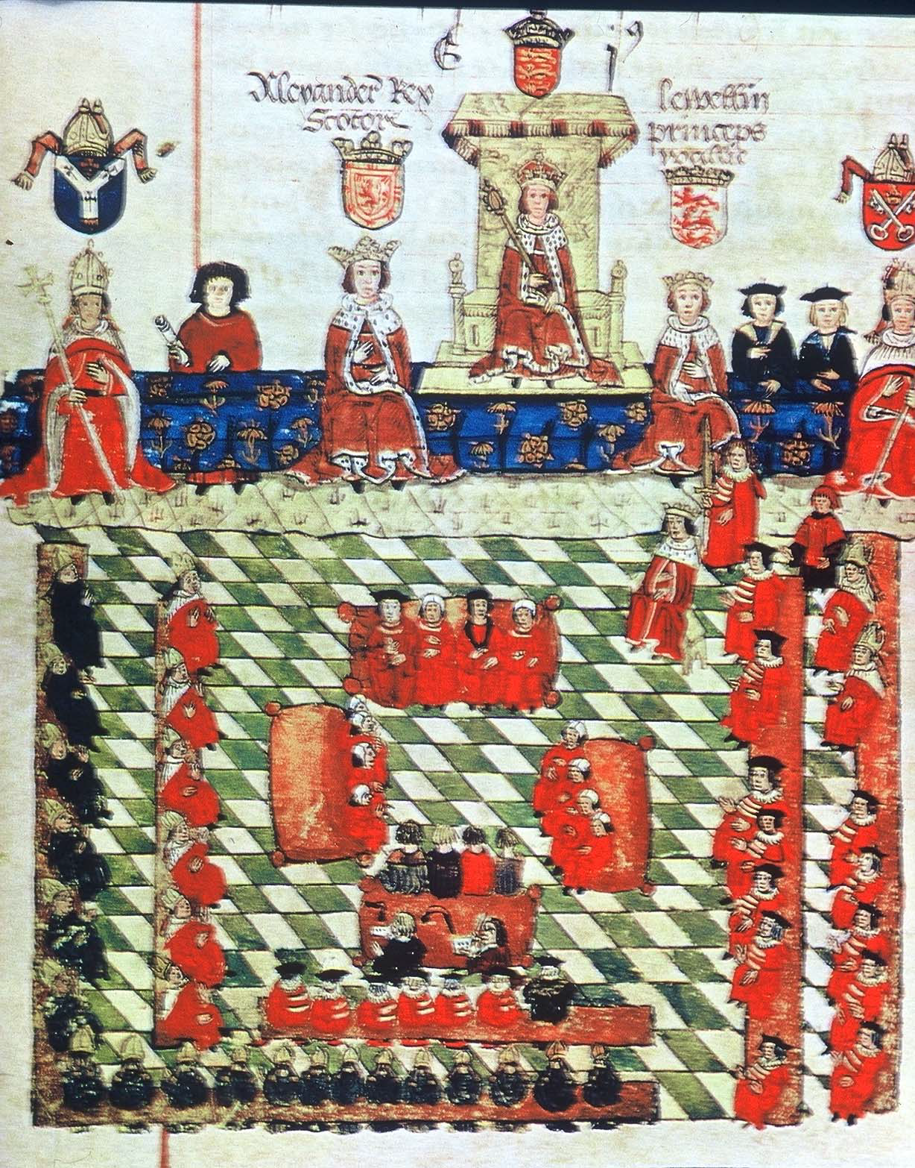

Slide 31
What is the overarching theory? (the Wriothesley ms)
This image of parliament would seem to depict Edward I presiding over parliament in 1278. Edward is flanked by Alexander III of Scotland and Llywelyn the Last of Wales, although they probably did not attend any of Edward’s parliaments. The earliest known example of this image is in the Garter Book written and illustrated for Sir Thomas Wriothesley c. 1524, where the image also appears in another version that corresponds, quite accurately, to the opening of parliament in 1523. The lords spiritual are seated to the king’s right, the lords temporal to his left, and in the center probably sit the justices and law officers. No commons are present at this parliament. There are many puzzles about this image, not the least of which is why the archbishop of York, identifiable by his shield, is depicted on the king’s far right and the archbishop of Canterbury at his far left, while precedence would suggest that it should be the other way around.

Slide 32
What is the overarching theory? (both mss)
We have to be careful with images like this, made long after the events. It is unlikely that an artist of 1278 would have given such prominence to Scotland and Wales, but he might have done so in 1300. What might well have featured as early as 1278 is the church, the nobility, and the ministers of the king. If the Parker manuscript emphasizes the role of the king, as both a mortal man and as the emodiment of an undying institution, this one emphasizes the king as the head of various communities, the community of the prelates of the church and that of the nobility, each, perhaps, representing wider communities of the lower clergy, and the laity.
To tie this into Aristotle is difficult. Anyone who is seeking to apply Aristotle to the situation of the late 13th century is going to have to come to grips with the fact that Aristotle would not have had the foggiest idea of what is going on in either of these images. It takes so much pulling and hauling to get Aristotle’s theory to apply to this world that it might make us think that that theory was really quite irrelevant to it.

