Slide 1
Continental European Constitutional and Legal History: Politics, Institutions, Regnum and Socerdotium (cont’d), the ‘Big Bang’, Why Bologna?
Lecture 7a
Click here for a printed outline.

Slide 2
Introduction
“Pur avoider le stuffing del rolls ove multip
The first part of this lecture summarizes the political background of some of the institutional developments that we are going to talk about later in the lecture. The cast of characters and their dates are given at the head of the outline. The basic point is that by the end of the thirteenth century we have four quite vibrant monarchies in England, France, Castile, Aragon, and, one, or perhaps two, in Sicily and Naples; some rising city-states in northern Italy, and a lot of particularism with a weak empire in Germany. The lecture then moves on to the growth of representative institutions and says a few words about courts. Next it comes back to what we were talking about on in the previous lecture, the role of the church. Finally it introduces a topic that will take several lectures to cover: The explosion of the academic study of law at Bologna.

Slide 3
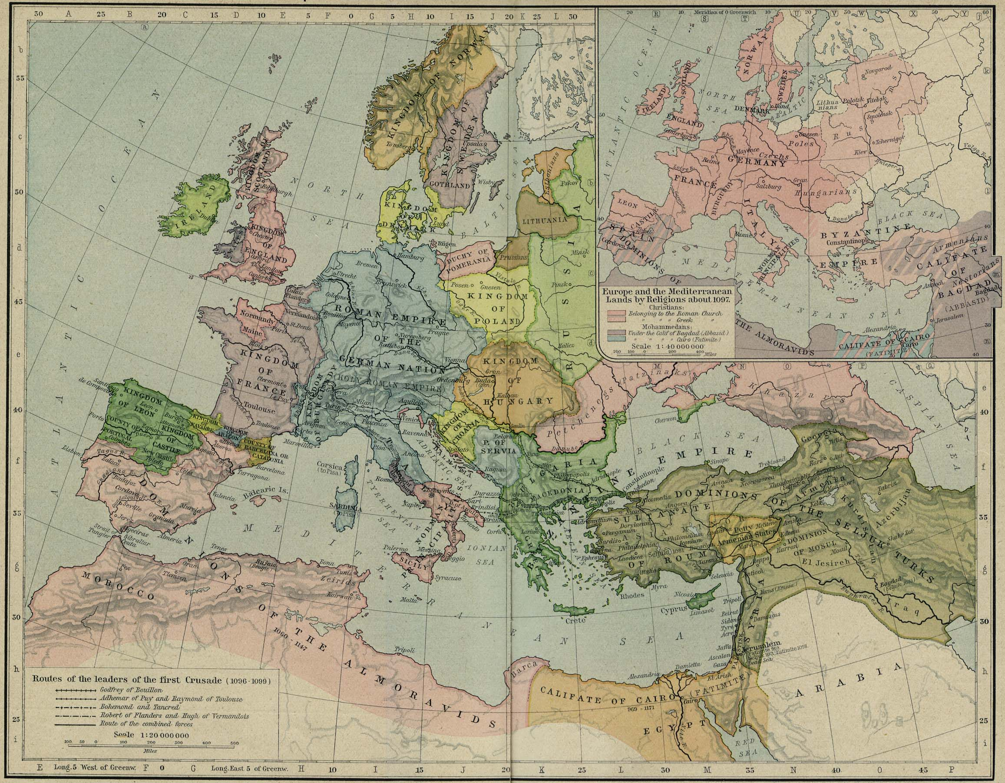
Political and religious map of Europe 1097

Slide 4
Empire and Italy
The Diet of Worms (settlement of the investiture controversy) – 1122
The commune movement
Frederick Barbarossa crushes Roman commune – 1155
Lombard League supports Alexander III, defeats Barbarossa – 1176
Sicily and Naples
Constance of Sicily, daughter of the Norman king Roger II, marries Henry VI of Germany, their son was Frederick II
Frederick II deposed by Innocent IV at the council of Lyons in 1245
Charles of Anjou, the younger brother of Louis IX of France, conquers Sicily – 1266

Slide 5
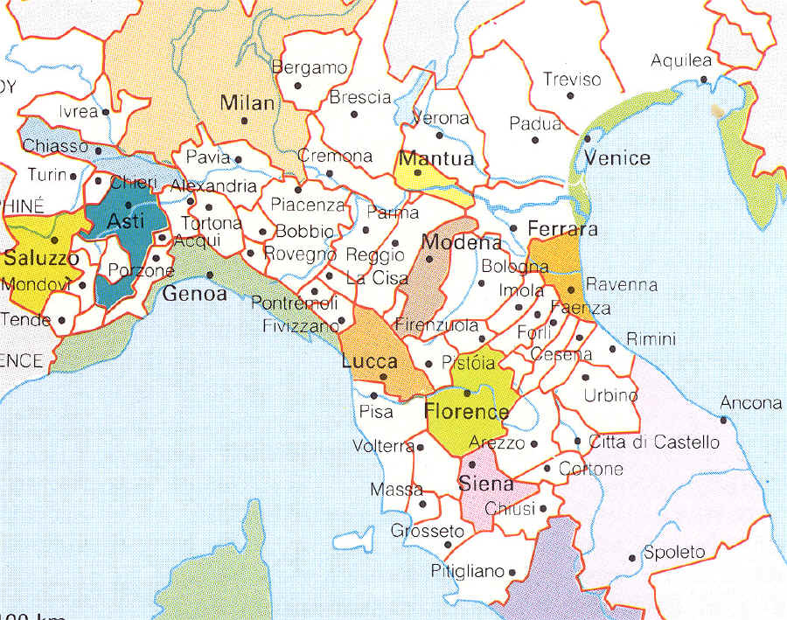
Empire and Italy (cont’d)
Richard of Cornwall of England and Alfons the Wise of Castile vie for the imperial crown, but the electors give it to Rudolf of Hapsburg
The electors depose Adolf of Nassau – 1298
The effect of the collapse of the Hohenstaufen dynasty

Slide 6
Empire and Italy (cont’d)
One might also have thought that this development would have left papal power to grow almost unchecked, but such was not the case. France emerged at the end of 13th century as a secular rival to papal power, and in the confrontation between Boniface VIII and Philip the Fair of France, Philip emerged triumphant. The papacy was to go into a long period of French domination resident at Avignon, just outside of the French king’s realm.

Slide 7
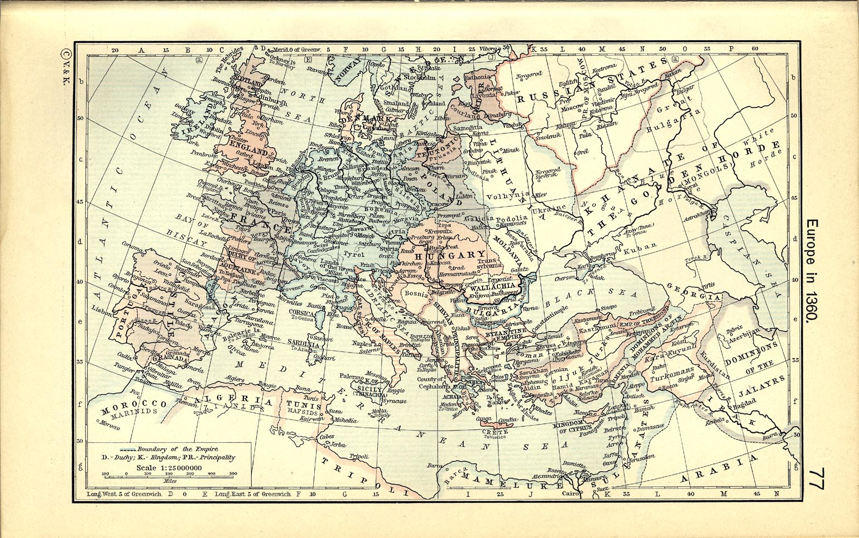
The political situation c. 1360
.

Slide 8
The development of the kingdoms: England
Relatively unified as a result of the Conquest in 1066.
Henry I develops the most powerful centralized fiscal and judicial institutions in all of Europe.
The Norman kings were also dukes of Normandy. Henry II’s marriage to Eleanor of Aquitaine made him lord of an empire that included not only England but the western half of France as well. Control of such an empire demanded strong delegates in England to mind the store while Henry was away.
John lost Normandy in 1204 and with it much of the Angevin empire. The struggles that ensued with his own baronage and which led to Magna Carta in 1215 and the struggles of his son Henry III with the same baronage did not have to result in the development of parliament at the end of the 13th century but that institution is easier to understand if we keep those struggles in mind.
.

Slide 9
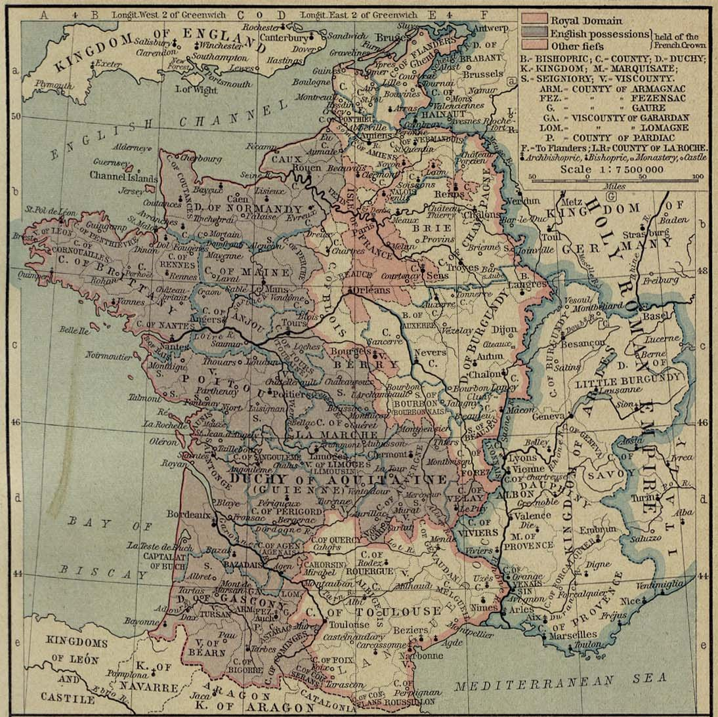
The develop- ment of the kingdoms: France
.

Slide 10
The development of the kingdoms: France (cont’d)
Where England began the 12th century strong, France began it weak. The French king was surrounded by powerful vassals, including the king of England, the count of Flanders, the duke of Burgundy, the count of Blois and Champagne, and the count of Toulouse.
The French king had effective power only in the royal domain, at the beginning of the 12th century only a relatively small region around Paris and Orléans.
Philip Augustus recovered for the French crown all of the northern domains of the English king, Normandy, Brittany, Maine, Anjou and Poitou, and developed central financial institutions within the royal domain. He parallels the role of Henry I of England, a half a century later.
The Albigensian crusade in the beginning of the thirteenth century ended by uniting the great province of Languedoc to the French crown, and eliminating the independence of the count of Toulouse and virtually eliminating the power of Aragon on the northern side of the Pyrenees.

Slide 11
The development of the kingdoms: France (cont’d)
Louis IX and Philip the Fair were able to consolidate these achievements, to develop institutions both judicial and financial that would ensure both royal order and royal control within this greatly expanded royal domain. By the end of Philip’s reign, we have clear indications of an institution known as the parlement of Paris and the beginning of an institution called the estates general. These institutions divided between them what was done in England in one parliament.

Slide 12
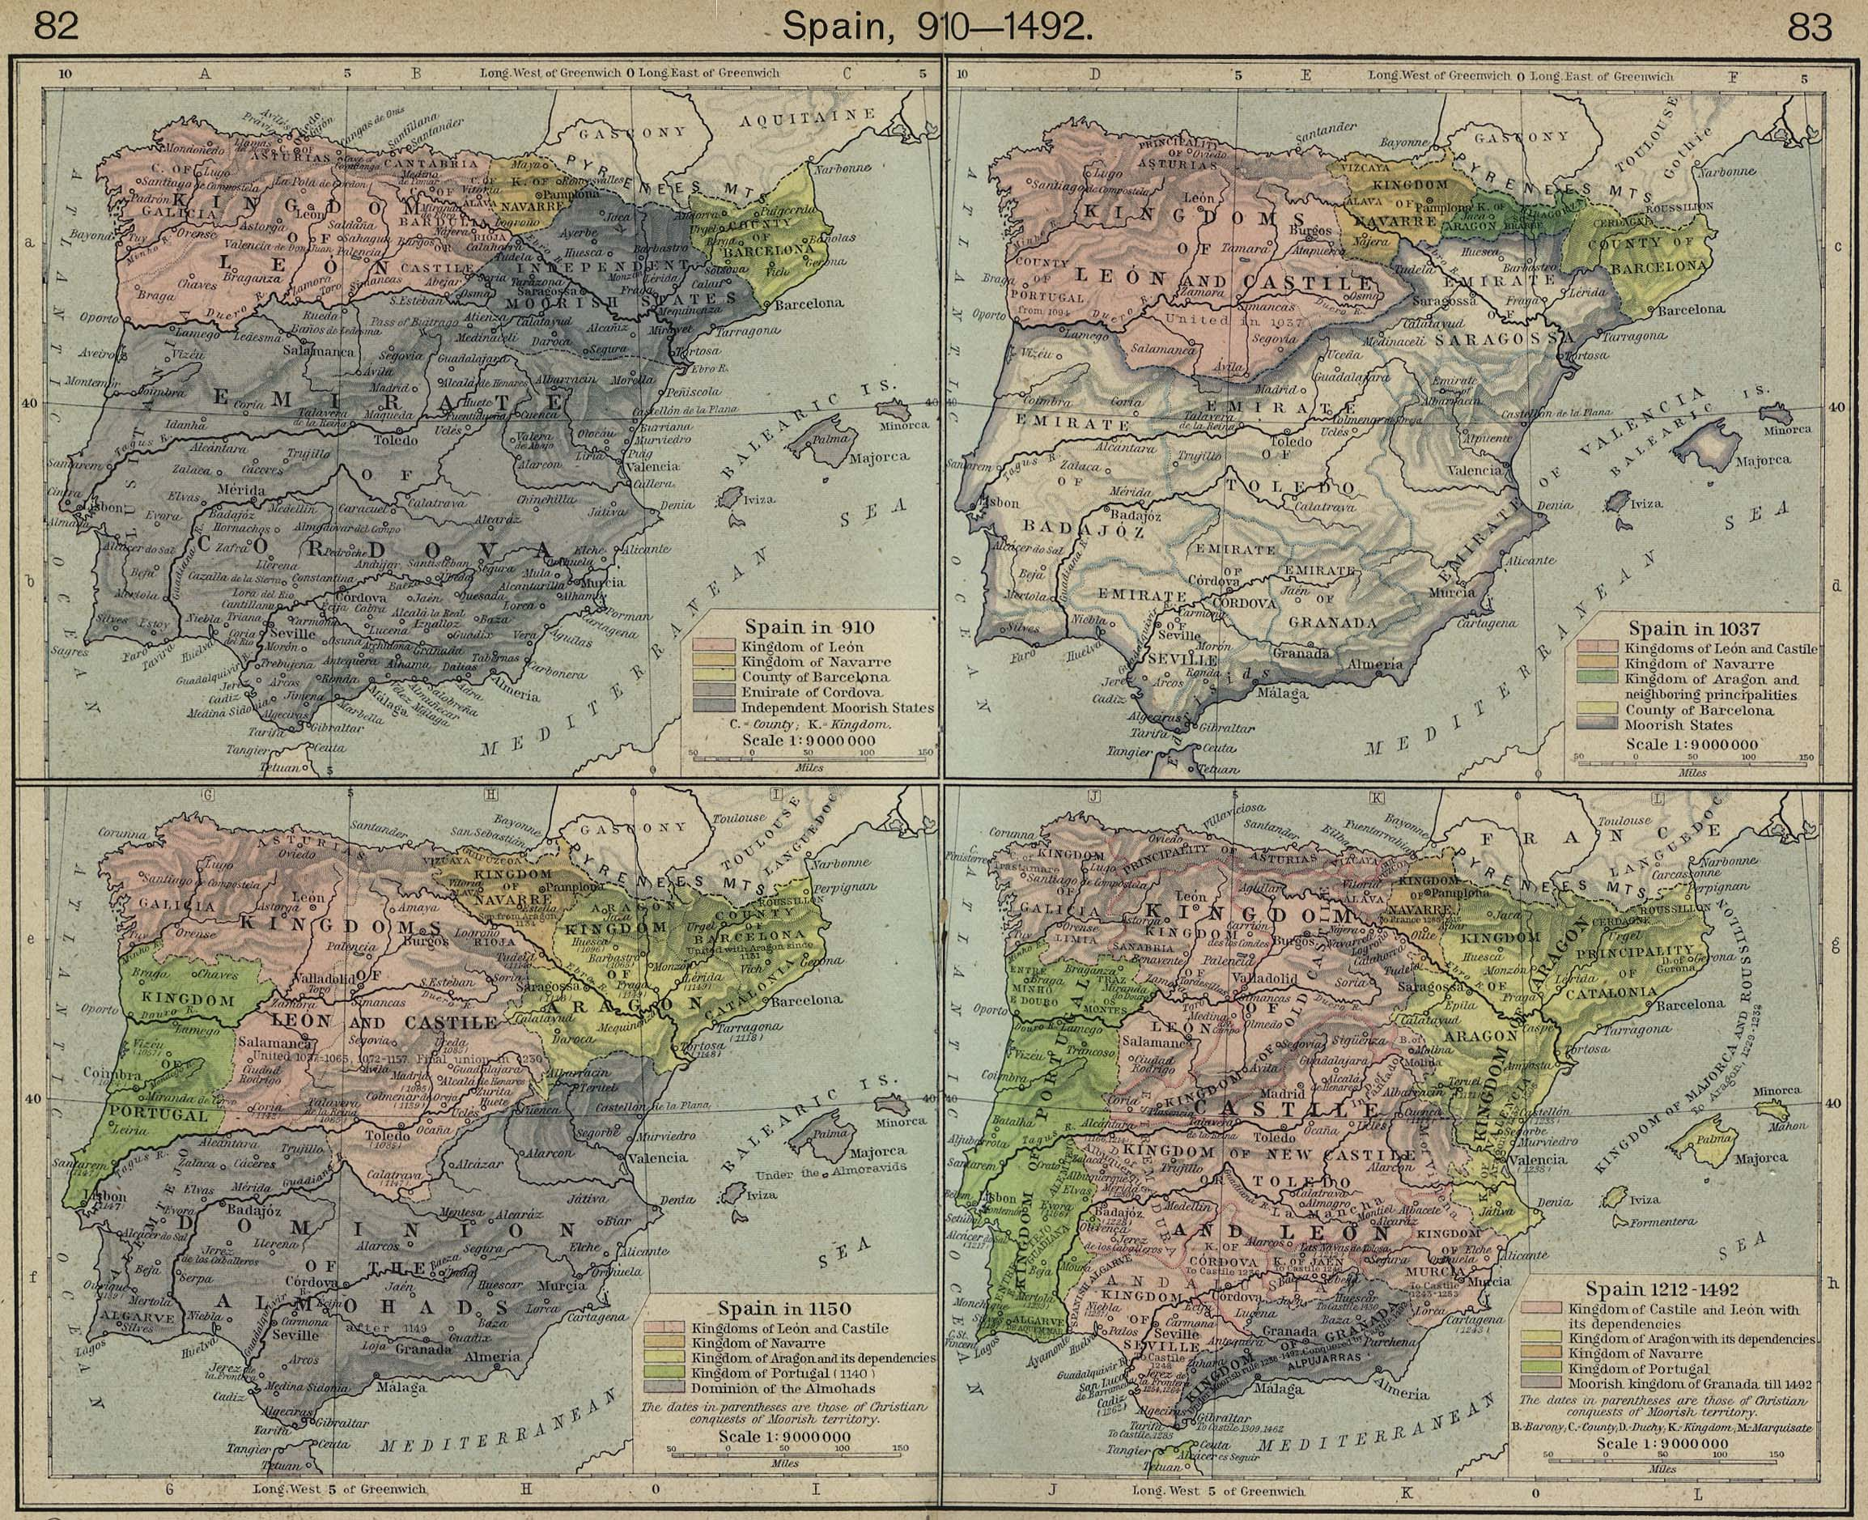
The development of the kingdoms: Iberian Peninsula

Slide 13
The development of the kingdoms: Iberian Peninsula (cont’d)
In the 11th century the Christians in the northern fringe of the peninsula were organized into small kingdoms: Leon, Castile, Navarre, Aragon, and the county of Barcelona.
By the beginning of the 12th century Alfons VI of Castile succeeded in uniting the crowns of Leon and Castile and recovering the center of Spain, as far south as Toledo.
In the mid–12th century, Portugal became a separate kingdom.
In 1137, Raymond Berenguer IV, count of Barcelona, united Catalonia with Aragon by marrying the heiress to the Aragonese crown. Peter II of Aragon sided with the Albigensians and lost most of the control that Aragon had in southern France. His son, however, James I, conquered the Balearic Islands; later he reconquered Valencia from the Moors. He established his son Peter on the throne of Sicily (the island only) and Sicily became divided from the kingdom of Naples, a situation that was to last into the 15th century.

Slide 14
The development of the kingdoms: Iberian Peninsula (cont’d)
In the meantime, James’s contemporary Ferdinand III of Castile recovered most the center of what is now Spain for Castile. By 1250 all remained in Moorish hands was a small area around Granada.
It was to remain in Moorish hands until 1492, 18 yrs. after the crowns of Castile and Aragon were united under Ferdinand of Aragon and Isabella of Castile. Alfons X of Castile had the job of consolidation and establishing institutions. He was only partially successful. Alfons never succeeded completely in bringing the nobility under his control. Leon, though it was united with Castile, had its separate cortes, an institution that roughly corresponds to the English parliament. Similarly, though the kingdom of Aragon, the county of Barcelona (now increasingly called Catalonia) and the principality of Valencia were all united under one crown, each had its own cortes. The nobility was strong in Aragon and Valencia, the cities in Catalonia. Navarre was not united with the rest of Spain until the 16th century.

Slide 15
The Growth of Representative Institutions and Courts
Diet of Roncaglia, 1158, Frederick Barbarossa:
counsel
oath-taking
judgment
urban element
the four doctors
the urban judges
By the end of the thirteenth century if not before these elements have been reinforced, at least in some areas, by some theory:
the idea of corporation (universitas)
the idea of power of an agent to bind (plena potestas)
the idea of consent (quod omnes tangit debet ab omnibus approbari)
the idea of status – ‘state’ in both senses of the English word and ‘estate’

Slide 16
The Growth of Representative Institutions and Courts
As the 12th and 13th centuries see a proliferation of institutions, developing out of older ideas of counsel, oath-taking and judgment, out of the growth of administration, out of the growth of corporate life, out of the church, it should not surprise us that things that look more like what we would call courts appear as spinoffs in different places.
the king or the pope or the emperor is the greatest judge of all
to give judgment in the central assembly was the most solemn kind of judgment one could give
judges associated with the growth of administration
by the middle of the 13th century almost every bishop in the West had his own court
we are least well informed about justice at the lowest levels, particularly in rural areas

Slide 17
Regnum and sacerdotium revisited
The reform movement (from 1000 into the 13th century) is much broader than the investiture controversy (1073 to 1122).
The theory of the reform movement
Separation of clerical from lay, to symbolize the separation of spiritual from temporal
The control of the temporal by the spiritual
The theory in support of regnum
Secular power comes from God
Theocratic kingship
Roman law
A move to the rule of law?
On the secular side: the development of hereditary monarchies and lordships
On the secular side: parliaments
The development of courts, those of the church and those of the secular authorities, taming the exercise of local power.

Slide 18
The ‘big bang’: the origins of the studium at Bologna
The Codex Florentinus (formerly Pisanus), the grandfather of all western manuscripts of Justinian’s Digest, was in the library at Pisa from the 12th to the 15th century (1406), when it was taken to Florence as war booty, and where it has remained ever since. It dates from the late 6th century, and may be an official copy of the Digest. The manuscript may have been copied at Monte Cassino, during the abbacy of Desiderius, 1058–86 (later Pope Victor III, 1086–87). Beneventan marginal notes in the manuscript suggest that there may be some truth to story that the manuscript was at Amalfi (just south of Naples), but whether it was taken by Pisans when they captured Amalfi in 1135 cannot be certain. (The proximity of Monte Cassino to Amalfi can been seen on the map on the next slide.)

Slide 19
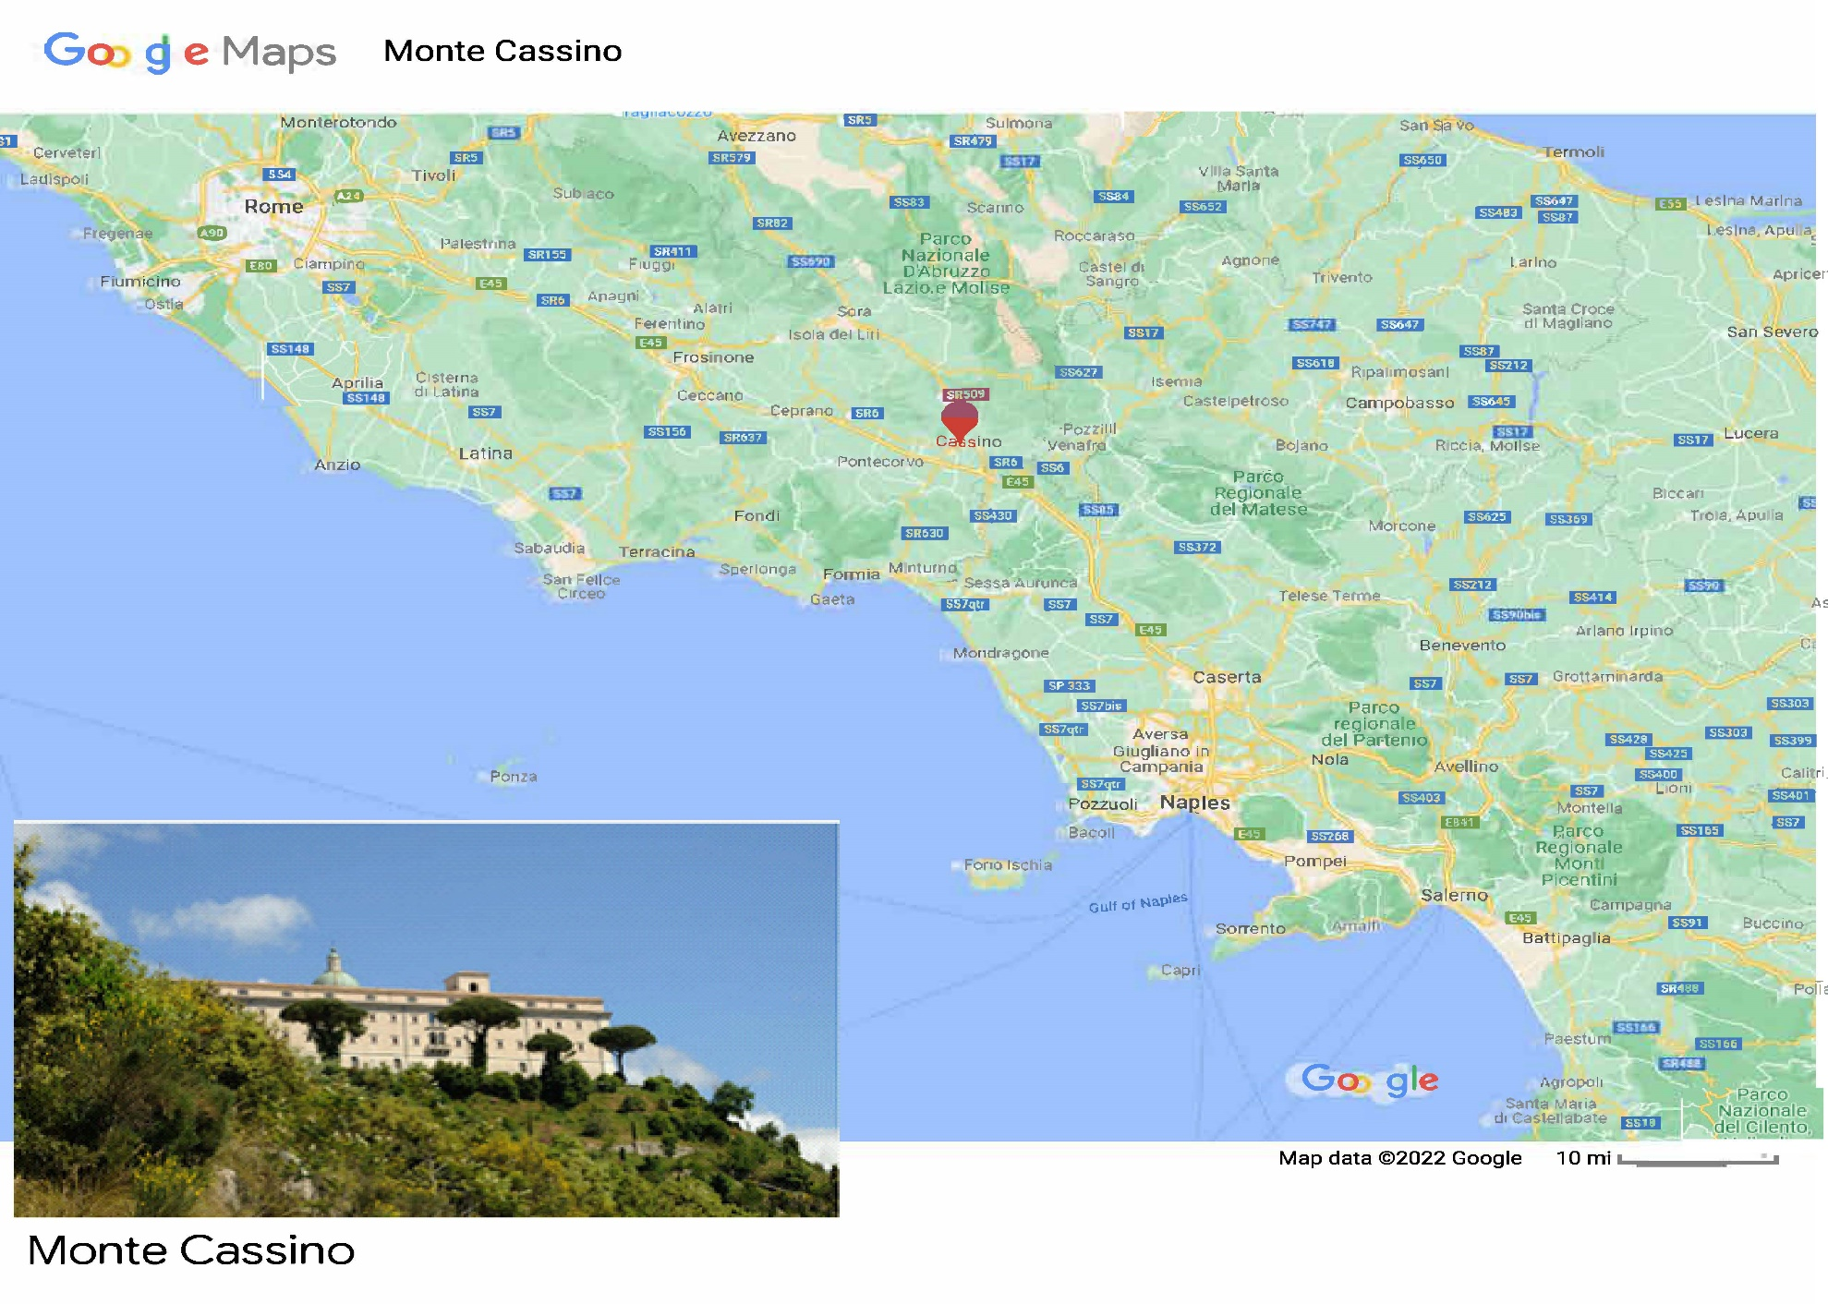
The ‘big bang’: the origins of the studium at Bologna (cont’d)

Slide 20
The ‘big bang’: the origins of the studium at Bologna (cont’d)
Another probable legend: that a law school migrated from Rome to Ravenna in the 11th c. It ties in, however, with the story, perhaps not legendary, that the manuscripts for Bolognese study in the 12th c. came from Ravenna.
Here is how Odofredus, a mid–13th c. law professor at Bologna tells the story of the origins of the studium there:
“A certain Sir Pepo began on his own authority to read in laws; Nonetheless whatever there was of his science was of no moment.
“But Sir Yrnerius while he was teaching in arts in that city when legal books were brought in began on his own to study, and studying began to teach in laws, and he was of great name and the first illuminator of our science, and since he was the first to make glosses in your books, we call him the lamplight the law.”

Slide 21
The ‘big bang’: the origins of the studium at Bologna (cont’d)
Who was Pepo? He may – emphasize ‘may’ – have been the schismatic bishop of Bologna in the 1080s. If so that would suggest a connection between the studium at Bologna and the emperor.
Irnerius is better known. He served as a judge on a number of occasions, principally for the emperor Henry V. On the other hand, there is a story reported in the twelfth century that Matilda of Tuscany, who died in 1115, was the founder of the studium at Bologna. She was a consistent supporter of the papacy during the investiture controversy. If she was the founder of the studium at Bologna, that would suggest that the papal party was looking for material to support its side of the argument. Irnerius is also found in documents associated with Matilda. He may have been a professional, in the sense that he could work for both sides and command the respect of both.

Slide 22
The glossators of Roman law (B=Bolognese; M=‘Gossiani’)
a. Irnerius (d. c. 1130)
b. Martinus Gosia (d. c. 1160), Bulgarus de Bulgarinis (d. c. 1166), [H]Ugo de Porta Ravennate (d. 1166 X 1171), Jacobus de Porta Ravennate (d. 1178) – the four doctors – advised Frederick I at the Diet of Roncaglia in 1158
c1. Rogerius (d. c. 1170) (M), Johannes Bassianus (d. c. 1190) (B), Placentinus (d. 1192) (M), Vacarius (d. c. 1198)
c2. Pillius Medicinensis (d. c. 1210) (B), Azo (d. 1220) (B)
d. Hugolinus (d. c. 1235), Roffredus (d. c. 1243), Accursius (d. 1263), Odofredus (d. 1265), all students of Joh. Bas. and/or Azo

Slide 23
The glossators of Roman law (cont’d)
The teaching of law began with a text, in this case the Corpus Iuris Civilis, and the principal function of a lecture was just what the word implies etymologically, reading the text. There was nothing new about reading a text and about glossing a text. What does seem to be new was that in addition to what we might call the simple gloss, the marginal or interlinear annotation that explains a word or passage, the legal glossators of the 12th century focused on parallel passages. Where else in the book is this topic treated and is the treatment similar to or different from the treatment given here? Finding parallel and contradictory passages leads to attempting to resolve the contradictions. And the methods of resolution that they used have been used from that day to this. They are the heart of what we call legal method, “thinking like a lawyer.”

Slide 24
The glossators of Roman law (cont’d)
Even this may not have been totally new with the earliest glossators of the Roman legal texts. Some of the same methods may already have been being used with the Bible. Ivo of Chartres, a French canonist of the late 11th and very early 12th century, has an extraordinary preface to his canonic collection called Panormia that lays out a method for resolving contradictions among the canons in abstract form. But in the glossators of Roman law, we see the program carried out with an extensive body of legal material. In the next lectures, we’ll look at some examples of what they did.

Slide 25
Why did Bologna happen?
How would you evaluate the following propositions as “explanations” of the extraordinary revival of legal studies in the twelfth century? You may take the “facts,” some of which are controversial, as true.
1. The conflict between regnum and sacerdotium. As we have seen, just because the investiture controversy was settled at the beginning of the 12th century that doesn’t mean that the tensions that underlay it disappeared nor does it mean that reformist zeal ceased. The 12th century, after all, was the century of the conflict between Becket and Henry II of England, Alexander III and Frederick Barbarossa.
2. Economics. The twelfth century saw an extraordinary revival of economic activity. Numbers are hard to come by, but some economic historians estimate that the percentage growth of gross domestic product in western Europe in the twelfth century was greater than in the sixteenth century, perhaps even than in the nineteenth century (the other two leading candidates for the centuries of greatest economic growth before the twentieth).

Slide 26
Why did Bologna happen?
3. The revival of culture. In France, there is an extraordinary flowering of sculpture and architecture in the great Romanesque churches of central France and the very beginnings of Gothic in the north. There is a notable revival of secular literature. In the south of France the Troubadour poets develop a love lyric the likes of which had not been seen in the West certainly since the Romans and perhaps never before. It is the century of Abelard and Heloise, of Henry II of England and Eleanor of Aquitaine, of a transnational Latin culture. It is perhaps the last century in which a man named John could be born in Salisbury in England, write the first original treatise of political thought since the Romans in a Latin as good as Cicero’s, and end his life as bishop of Chartres.
4. Contact with the East. The first Crusade was conducted between 1096 and 1099. Whatever its true motivations, it resulted in a Latin Kingdom in Palestine that lasted, at least in part, for almost two hundred years and brought renewed contact between the Christian West and the Christian, Muslim, and Jewish East. Importation of ideas of Roman law, particularly from Byzantium, may have stimulated interest in such law in the West.

Slide 27
Why did Bologna happen?
5. The revival of other kinds of disciplines. The twelfth is a century of the study of the Bible and of what today we would call theology and philosophy in the monastic and cathedral schools, particularly in France. Abelard (d. 1148) is a major figure in this tradition, but his work probably comes too late to have influenced the beginnings of university study of Roman and canon law. The glossators of the Bible, however, certainly are early enough. The twelfth was also the century that saw by its end the development of a new discipline for which they still did not have a name but which we call moral theology.

Slide 28
Why did Bologna happen?
6. Increase in judicial activity, particularly in Italy. We know that in the eleventh century and probably before there was a law school at Pavia where Lombard law (a Romanic-Germanic mix) was studied. A recent book (by Charles Radding) has pointed out that the Pavese jurists served as judges, and Radding tries to argue that they were beginning what we might call legal method. There probably isn’t enough material that certainly antedates the revival at Bologna to make that statement with any confidence, though practical concerns at a lower level than the high politics of the reform movement are almost certainly important in the development of the method and of Bologna. All of the first Bolognese civilians are known to have acted as judges. An even more recent book (by Anders Winroth) argues that Irnerius was largely mythical and that the real study of Roman law doesn’t get going at Bologna until the 1130s, by which time Gratian had already composed the first draft of his Concordance of Discordant Canons.

Slide 29
Why did Bologna happen?
7. The growth of canonic institutions. That the growth happened is clear enough from what we have said above. We’ll hear more about it. The problem is is this the chicken or the egg?
8. Violence. Despite all of these developments, which frequently go under the name of the “twelfth-century Renaissance” the twelfth century, particularly its first half was a very violent time. Castellans all over Europe beat up the peasants and spent a great deal of time fighting each other. The second half of the twelfth century, it has recently been argued (Thomas Bisson), sees the emergence of more centralized authority, itself pretty violent, but powerful enough to tame the castellans, at least in many areas. The more centralized authority (it wasn’t always kings) used accounting and then law (indeed the two were inextricably intertwined) to exercise their power when they were not doing it with force of arms.

