Slide 1
Continental European Constitutional and Legal History: The Carolingians and Feudalism
Lecture 5
Click here for a printed outline.

Slide 2
Political History from Clovis (d. 511) to Henry IV (d. 1106)
The starting point of the story is not in Europe. The starting point is in the Arabian peninsula with the rise of Islam as both a secular power and a religious group. Mohammed died in 632.
The starting point of the story is not in Europe. The starting point is in the Arabian peninsula with the rise of Islam as both a secular power and a religious group. Mohammed died in 632.
“Pur avoider le stuffing del rolls ove multip
At the beginning of our period Justinian is reigning; at the end of our period England is a Norman kingdom, France has become firmly separated from the Empire, and we can see the beginnings of Spain. The next lecture will focus on the church, particularly the reform movement of the 11th century. This lecture will focus on the political separation of France from the Empire and the development of institutions that a later age has summed up under the name ‘feudal’.
European law eventually emerges under the auspices of territorial nation-states as a mixture of Roman, canonic, and customary elements. It is the customary elements that most easily become associated with the national. But at the beginning of the 6th century there were no nations. There weren’t any at the end of the 11th either, but there were territorial kingships in areas that later developed into territorial nation-states, England, France, and Spain being the most notable. How that came about is intimately connected with the story of the Franks. But in order to understand how the Franks became important, we have to start a bit later.
The starting point of the story is in the Arabian peninsula.

Slide 3
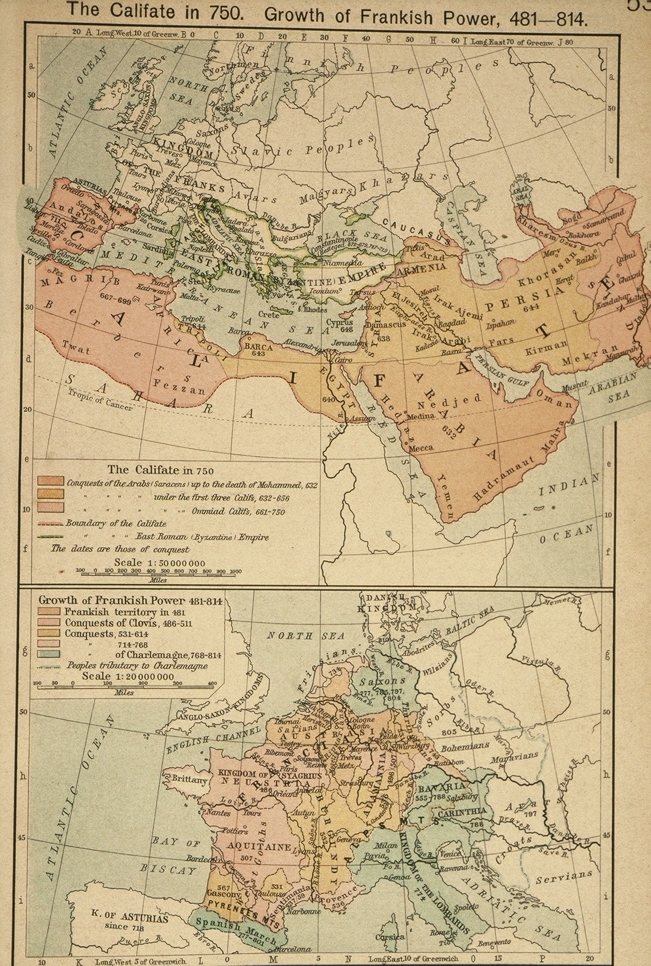
The rise of Islam (Mohammed died in 632)

Slide 4
The rise of Islam (cont’d)
At the time of Mohammed’s death Islam had already spread throughout the Arabian peninsula. Within twenty years of his death the Arabs had spread themselves and the new religion over the former Persian empire, Palestine, and north Africa as far as Tripoli. They constituted an obvious threat to Byzantine power in Asia Minor. By a century after Mohammed’s death Muslims (notice I don’t call them Arabs here) had taken the rest of North Africa, had destroyed the Visigothic kingdom in Spain and had moved east into what is now Afghanistan and Pakistan. The unity of the Mediterranean world was broken. That is obvious enough from the map. Because the attention of Byzantine empire was turned toward the east, the unity of the Christian world was also broken, though in more subtle ways. Finally, in Western Europe attention turned north to the Franks.

Slide 5
The rise of Islam (cont’d)
Before we leave the southern Mediterranean, we should add some notes of caution. Islam eventually developed into a great civilization. It also developed one of the great religious systems of law. The civilization was ultimately to have considerable influence in the West, particularly as a vehicle for conveying Greek philosophy into the high Middle Ages. Trade with the east and south was also, ultimately, revived (some would argue that it never really stopped), and it is probably because of trade that we today use the Arabic system of numbers, not the Roman. But the 8th century saw the Islamic invasions as nothing but the introduction of an alien element that was too different to be absorbed. The influence of Islamic law on Western law was minimal, except for a few areas in Spain.
The collapse of the Visigothic kingdom in 711 was a frightening event for the Christian west, particularly because it could not count on support from Byzantium. In northern Europe a new power had been emerging since the beginning of the 6th century, a power that had come to rival that of the Visigoths.

Slide 6
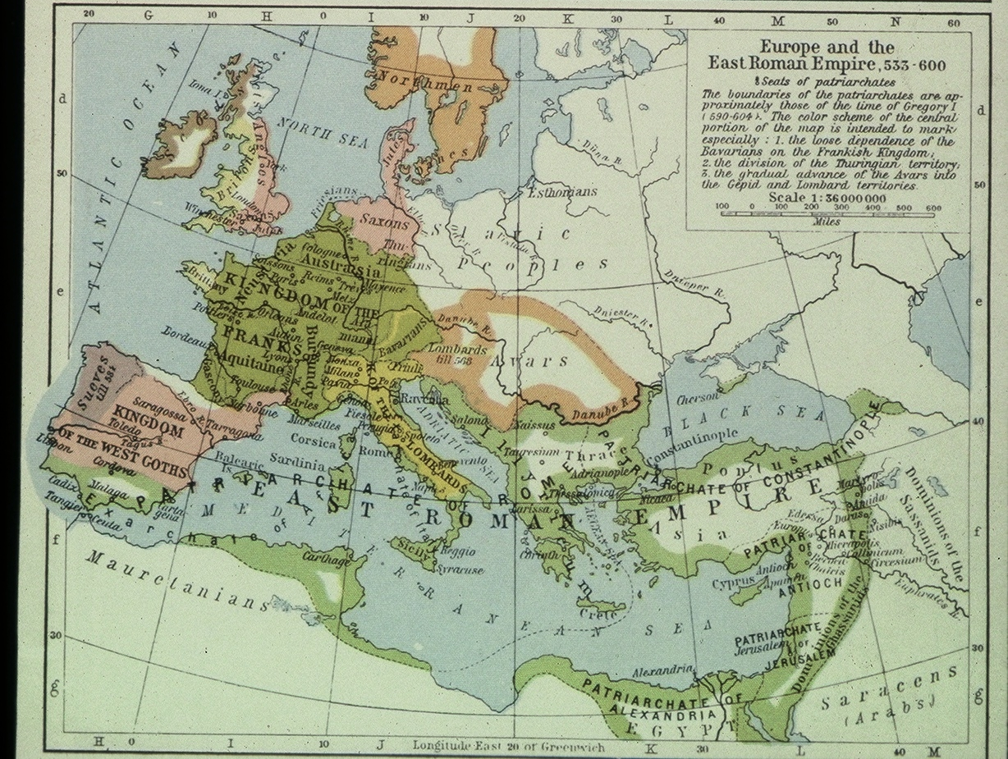
The Franks in roughly 600

Slide 7
The Franks (cont’d)
.
The map above shows the growth of Frankish power from 481 to 814.

Slide 8
The Franks (cont’d)
Years | Kings and Emperors
486 – 511 | Clovis, grandson of Merovich, king of the Franks, becomes orthodox Christian
629 – 639 | Dagobert, last effective Merovingian king of the Franks
640 – 751 | The rois fainéants, ‘do-nothing kings’
680 – 714 | Pepin of Heristal, mayor of the Austrasian palace unites the palaces
714 – 741 | Charles Martel, mayor (732(3), won battle of Tours/Poitiers)
741 – 751– 768 | Pepin the Short, mayor then king, moves against the Lombards
768 – 814 | Charlemagne, king (emperor, 800 – 814)
814 – 840 | Louis the Pious (emperor)

Slide 9
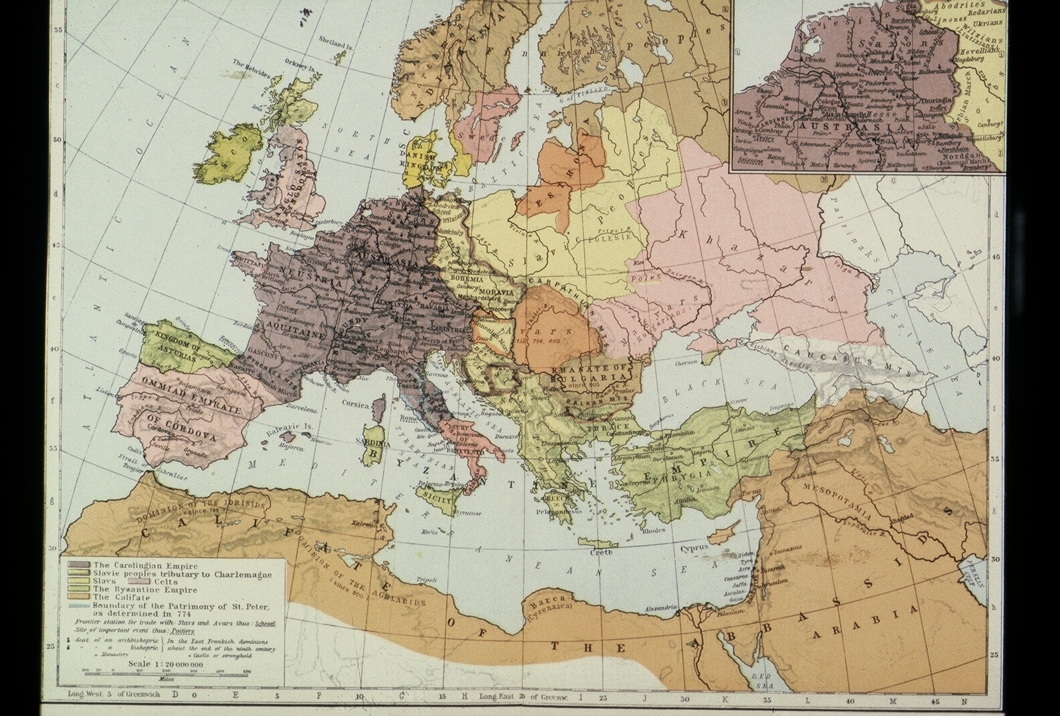
Carolingian empire, Byzantine empire, Califate, in 814.

Slide 10
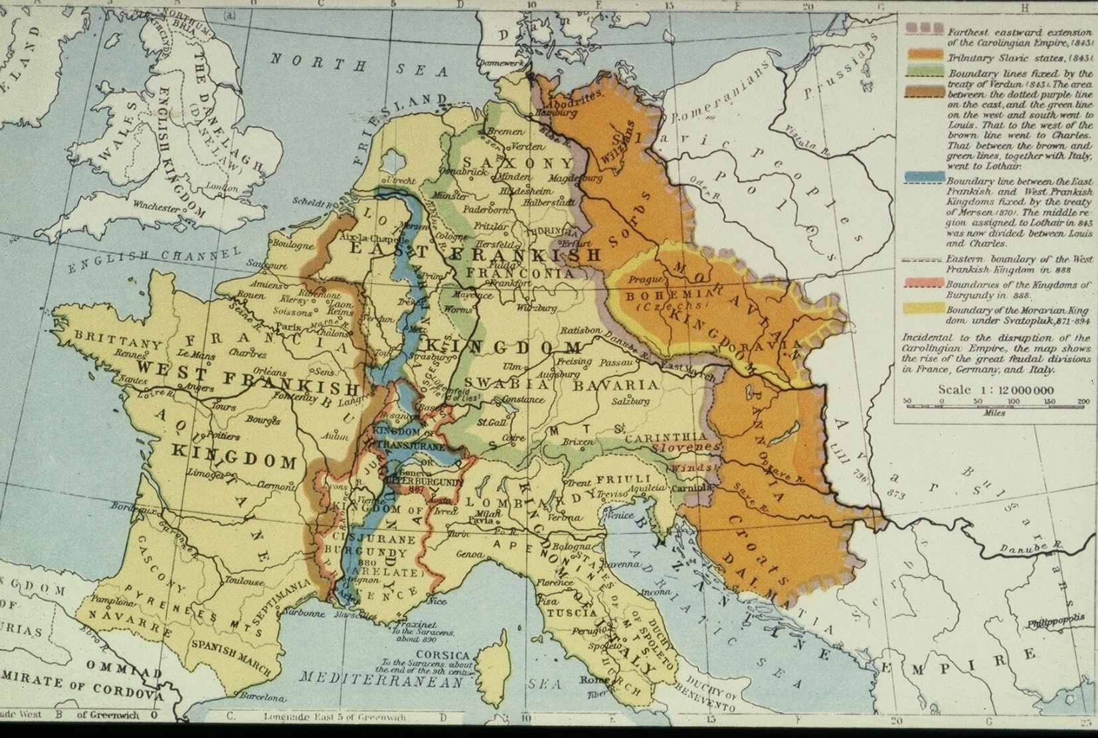
The breakup of the Carolingian empire from 843–888.
West | Middle | East
840–77 Charles the Bald | 840–55 Lothair, emp. 855–69 Lothair II | 840–76 Louis the German

Slide 11
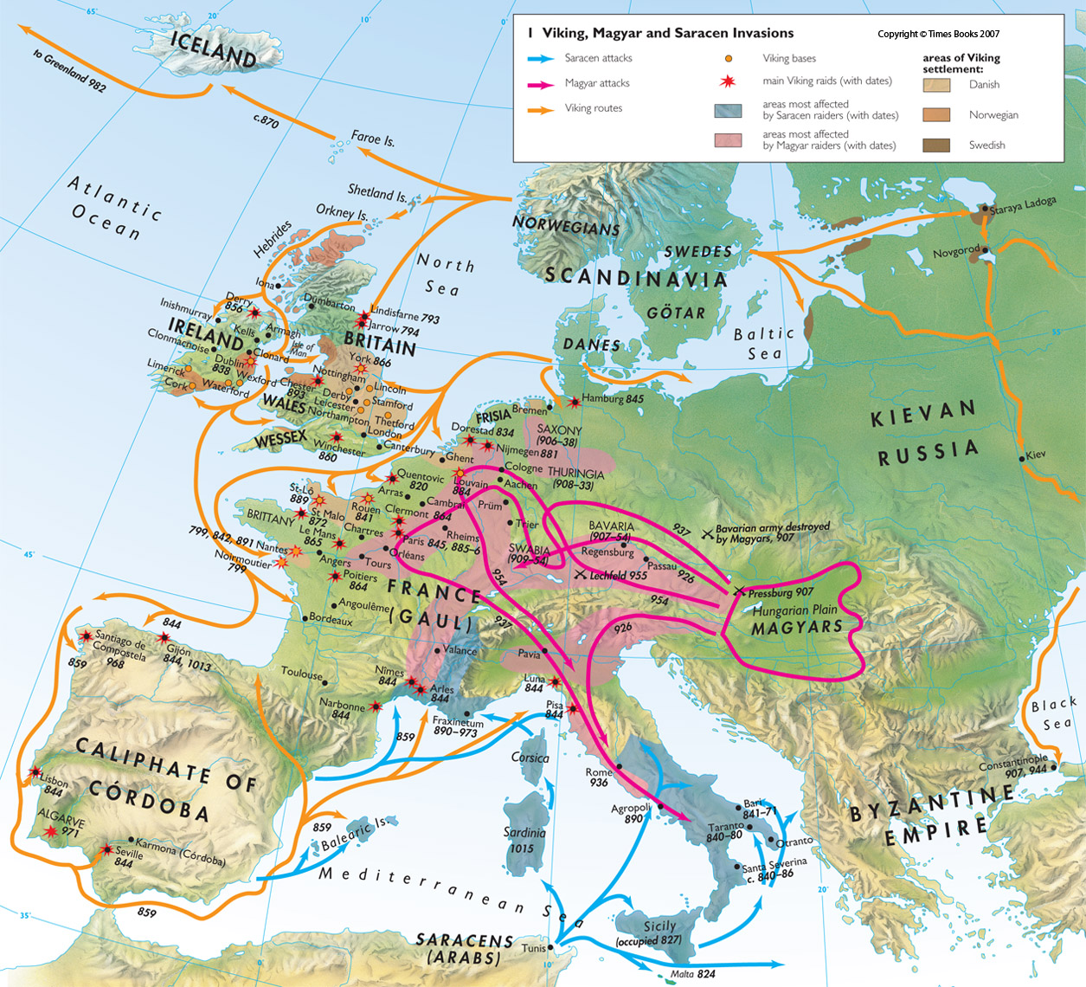
9th and 10th century invasions

Slide 12
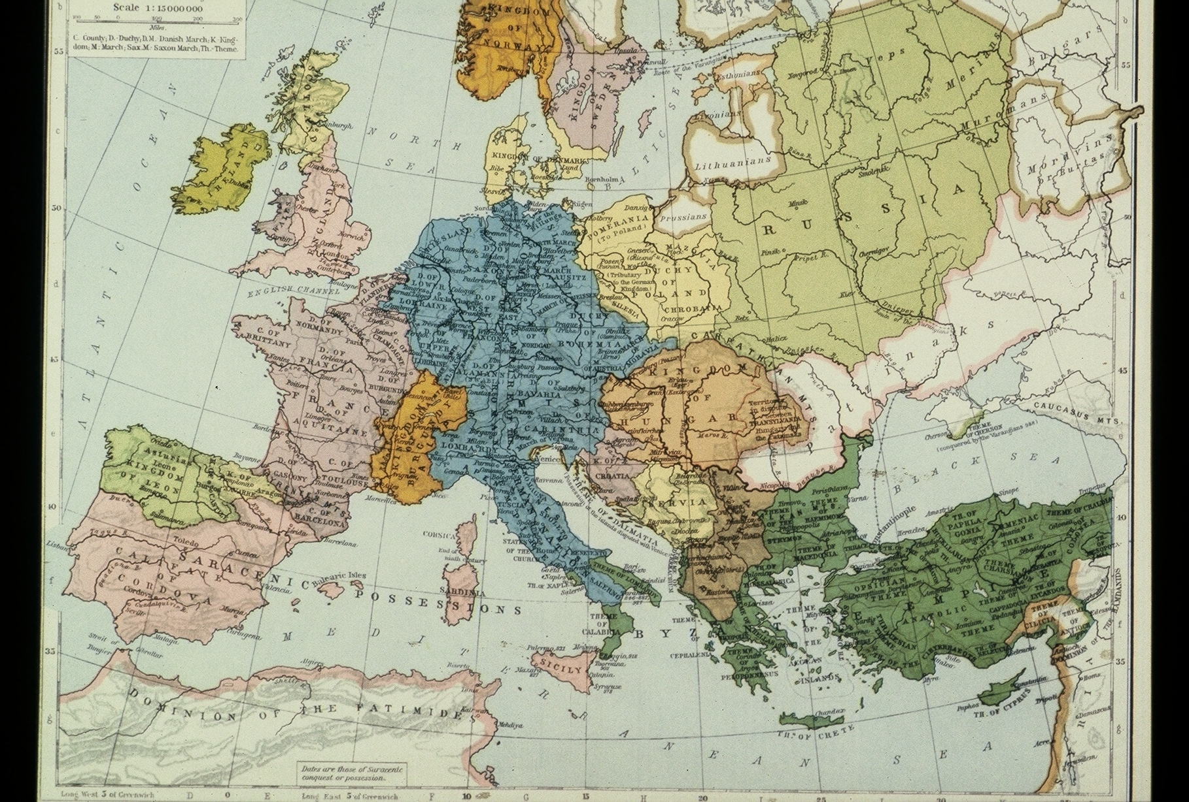
Europe and the Byzantine empire about the year 1000.

Slide 13
Rulers of France and Germany, 898–1108
France | Germany
898–922 Charles the Simple | 919–36 Henry the Fowler
 | 936–62–73 Otto the Great, kg. emp. 973–83 Otto II
987–96 Hugh Capet | 983–1002 Otto III
 | 1002–1024 Henry II
996–1031 Robert II the Pious | 1024–39 Conrad II
1031–1060 Henry I | 1039–56 Henry III
1060–1108 Philip I | 1056–1106 Henry IV

Slide 14
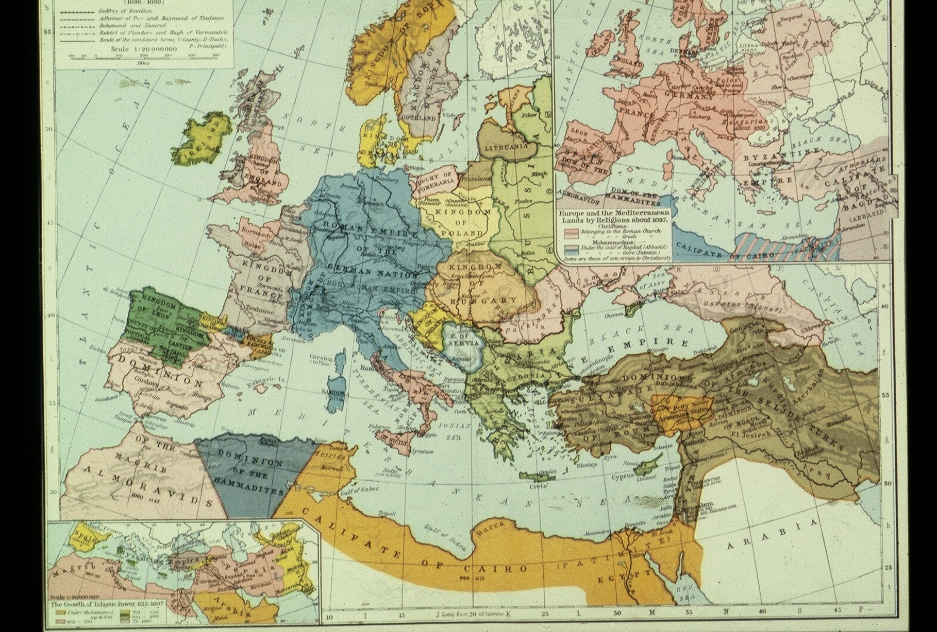
Europe and the Mediterranean lands in roughly 1097
.
The upper-right inset divides Western and Eastern Christians and Muslims (the latter divided between the calif of Baghdad and that of Cairo).

Slide 15
Feudalism
Feudalism is topic of hot controversy.
The Problem of Definition—the Social View
A type of economy, built around the manor, in the model, though not always in reality, the manor is coextensive with the vill, with open fields, lord, priest, free tenants, serfs and a lord’s court to manage the whole.
A type of society characterized by multiple relationships of dependency, lord and man (vassal), with mutual obligations of support, particularly military, summed up in the ceremonies of homage and fealty.
The Problem of Definition—the governmental-legal view
Feudalism is a pyramidal structure of governance, based on landholding in which the king rules his tenants-in-chief, they their vassals down to the peasant. Every man owes suit in his lord’s court, only the tenants in chief owe it in the king’s.
.

Slide 16
Feudalism (cont’d)
Feudalism is a pyramidal system of land holding whereby all land is holden of the king for service usually knight’s service and the tenants in chief parcel out the land to subtenants for service, knights and other things: knight’s service, serjeanty, socage, frankalmoign and incidents, suit of court, aid, wardship, marriage, relief, primer seisin, escheat.
The broader social/economic pattern is present in all the major w. European countries in the M.A., but it may well have been there before the break-up of the Carolingian empire. The legal/governmental definition of feudalism is another story.
I can’t give you a law-book about feudalism. I can give you law-books that show plenty of feudal institutions. There is a book called the Libri feudorum. It’s a glossators’ book from 12th century Italy. It’s late for our purposes, and it comes from a time when feudal institutions were already competing with other types of institutions for legal recognition. There’s a collection of documents in Section IV of the Materials that may help.
.

Slide 17
Feudalism (cont’d): the Merovingian and Carolingian evidence
II want to make a tricky argument. I want to use the documents that were used by earlier historians of feudalism to show how a feudal age originated in the Carolingian period or shortly after to show how the same documents do not add up to that. If there was a feudal age – a proposition about which I am becoming somewhat skeptical – it is to be dated in the 11th and 12th centuries.
[Doc. A: the antrustio c. 650]: [Elements: (1) arms, (2) aid and protection, including a special wergeld, no land, (3) ceremony of homage described.] “It is right that those who have promised us unbroken faith should be rewarded by our aid and protection. Now since our faithful subject ___ with the will of God has come to our palace with his arms and has there sworn in our hands to keep his trust and fidelity to us, therefore we decree and command by the present writing that henceforth the said ___ is to be numbered among our antrustiones. If anyone shall presume to slay him, let him know that he shall have to pay 600 solidi as a wergeld for him.”
.

Slide 18
Feudalism (cont’d): the Merovingian and Carolingian evidence
[Doc. D—commendation c. 750.] “To my great lord, ___, I, ___. Since, as was well known, I had not wherewith to feed and clothe myself, I came to you and told you my wish, to commend myself to you and to put myself under your protection. I have now done so, on the condition that you shall supply me with food and clothing as far as I shall merit by my services, and that as long as I live I shall perform such services for you as are becoming to a freeman, and shall never have the right to withdraw from your power and protection, but shall remain under them all the days of my life. It is agreed that if either of us shall try to break this compact he shall pay ___ solidi, and the compact shall still hold. It is also agreed that two copies of this letter shall be made and signed by us, which also has been done.”

Slide 19
Feudalism (cont’d): the Merovingian and Carolingian evidence
[Doc. I rules about vassals leaving the service of their lords (816, 847)] “If anyone shall wish to leave his lord and is able to prove against him one of these crimes, that is, in the first place, if the lord has wished to reduce him unjustly into servitude; in the second place, if he has taken counsel against his life; in the third place if the lord has committed adultery with the wife of his vassal, in the fourth place if has willfully attacked him with a drawn sword; in the fifth place, if the lord has been able to bring defense to his vassal after he commended his hands to him, and has not done so; it is allowed to the vassal to leave him. If the lord has perpetrated anything against the vassal in these five points it is allowed the vassal to leave him.”
The documents in Doc. I are capitularies, different from what we have seen before. They are clearly normative, but they are not like the Anglo-Saxon laws or the Burgundian laws. Rather, they seem to orders of the emperor that are more particular, somewhat like our regulations. Many of them are quite cryptic, and the written form is sometimes thought to be a series of notes for the emperor’s agents (missi) who would spell them out more fully orally in assemblies.

Slide 20
Feudalism (cont’d): the Merovingian and Carolingian evidence
The next step in the process is hard to discern, particularly from the documents that we have. It was assumed in the theories of feudalism of the previous generation, but many of the elements are speculative, and it is on this speculation that recent challenges to the whole notion of feudalism have been based. The traditional story goes like this:
Lords set up their vassals on land to supply them with their needs in return for services.
The invention of the knight. Stirrups and Charles Martel (Tours/Poitiers, 732/3).
These men had to be supported somehow and the church had a lot of land. (One can buy this step without the controversial element of the knight, which may well be later.)

Slide 21
Feudalism (cont’d): the Merovingian and Carolingian evidence
To hand were the legal ideas of precarium and beneficium. The former is a Roman-law term which means what we call a tenancy at the will of the owner of the land, the latter is a word that in classical Latin can mean a salary paid in return for service, particularly governmental service. [(Doc. B) (650)] shows us people holding land from a church by what looks like life tenure: “I, ___, and my wife, ___, in the name of the Lord, give by this letter of gift, and transfer from our ownership to the ownership and authority of the monastery of ___, over which the venerable abbot ___ presides, and which was founded in the honor of ___ by ___ in the county of ___, the following villas situated in the county of ___, with all the lands, houses, buildings, tenants, slaves, vineyards, woods, fields, pastures, meadows, streams and all other belongings and dependencies, and all things movable and immovable which are found in the said villas now or may be added later; in order that under the protection of Christ they may be used for the support and maintenance of the monks who dwell in the aforesaid monastery. (cont’d on next slide)

Slide 22
Feudalism (cont’d): the Merovingian and Carolingian evidence
“We do this on condition that as long as either of us shall live we may possess the aforesaid villas, without prejudice to the ownership of the monastery and without diminution of the value of them, except that we shall be allowed to emancipate any of the slaves that dwell on the lands for the salvation of our souls. After the death of both of us, the aforesaid villas with any additions of improvements which have been made, shall return immediately to the possession of the said monastery and the said abbot and his successors, without taking any judicial process or obtaining the consent of the heirs.” The problem is that most of the evidence that we have from this period is for gifts to the church. Whatever this is, it is certainly not a precarium or a beneficium.
The family came to the fore; vassals came to view benefices as their own. [Doc. F (Charlemagne 806)] “We have heard that counts and other men who hold benefices from us have improved their own property at the expense of the benefices, and have made the serfs on the benefices labor on their own land, so that our benefices are waste and those dwelling on them in many places suffer great evils. (cont’d on next slide)

Slide 23
Feudalism (cont’d): the Merovingian and Carolingian evidence
“We have heard that some sell the benefices which they hold from us to other men in full ownership, and then, having received the price in the public court, they buy back the lands as allodial lands. This must not be done, for those who do this break the faith which they promised us.” By the 9th c. [(Doc. J, 875)] in some areas the benefice seems to be inheritable, at least under some circumstances. “If a count whose son accompanies us shall die during our absence, our son with the advice of our faithful subjects shall appoint one of the near relatives of the deceased count to govern the county with the aid of the officials of the county and the bishop in whose diocese it is, until we are notified of the case and have an opportunity to give the son of the count his father’s honors. But if the deceased count shall leave a minor son, that son shall govern the county with the aid of the officials and the bishop in whose diocese it is, until the death of the said count has been brought to our notice and we endow the son with his father’s honors. But if the count shall not leave a son, our son with the advice of our faithful subjects shall appoint someone to govern the county with the aid of the officials of the county; and the bishop, until our commands in respect to it are made known. (cont’d on next slide)

Slide 24
Feudalism (cont’d): the Merovingian and Carolingian evidence
“And no one shall feel aggrieved, if we give the county to another than the one who governed it up to the time of our appointment. The same procedure shall be observed in regard to our vassals; and the bishops, abbots, and counts of our kingdom, and our other faithful subjects, shall do the same toward their men.” The document was issued by Charles the Bald and probably was intended to apply only to West Frankland. It was, as we have noted, probably not until the 11th century that it became firmly established in the Empire. if then.
Public functions become enmeshed in the process. [Doc. C (650)] From a very early time shows grants of immunity from jurisdiction were given to churches and monasteries. “We believe that our reign will best be rendered memorable, if we bestow suitable benefits on churches (or whatever you wish to insert here), with pious purpose, and if we secure these benefits under the protection of God by putting them in writing. Therefore, be it known to you that we have granted the request of that apostolic man, the bishop of ___, for the salvation of our souls, namely, that no public official may enter the lands which his church holds now, by our gift or by the gift of anyone else, or which his church may receive in the future, (cont’d on next slide)

Slide 25
Feudalism (cont’d): the Merovingian and Carolingian evidence
“for the purpose of trying cases, or collecting taxes; but that the said bishop and his successors shall hold the said lands in the name of the Lord with full immunity. We decree therefore that neither you nor any of your subordinates or successors, nor any other public official shall presume to enter the lands of the said church for the purpose of trying cases, or collecting taxes or revenues, or receiving entertainment or seizing supplies or securities. All the taxes and other revenues which the royal treasury has a right to demand from the people on the lands of the said church, whether they be freemen or slaves, Romans or barbarians, we now bestow on the said church for our future salvation, to be used by the officials of the church forever for the best interests of the church.” That these could run with the land even if that land came into the hands of a layman is suggested by Doc. J (875), above. These public functions too could become inheritable. The honor, the public office, was being treated like a benefice.

Slide 26
Feudalism (cont’d): the Merovingian and Carolingian evidence
The 9th century also gives us various pieces of evidence about bad lordship and overmighty royal officers. Doc. F (806, see above) concerns how difficult it is to get a royal official to treat his use of royal lands as not his own. Doc. G (805 X 829) contain, among other things, an interesting rule about witnesses (“Freemen who have no lands of their own, but live on the land of a lord, are not to be received as witnesses, because they hold land of another; but they are to be accepted as compurgators, because they are free. Those who have land of their own, and yet live on the land of a lord, are not to be rejected as witnesses because they live on the land of a lord but their testimony shall be accepted because they have land of their own.”), and much complaint about oppression (e.g., “Poor men complain that they are despoiled of their property, and they make this complaint equally against bishops and abbots and their agents, and against counts and their subordinates”). The fact is, however, that the emperor regards it as his job to do something about it.

Slide 27
Feudalism (cont’d): the Merovingian and Carolingian evidence
Doc. H (826 X 829) may be the most famous document from this period, a ninth-century survey of the estate of the great abbey of St. Germain near (now in) Paris. It shows us how a great lordship in the Carolingian period held its stuff together. Particularly interesting are the variations in status among the peasants (colonus, colona, slave, freed). If your definition of feudalism is confined to way great estates were managed with a dependent peasantry, it is clearly here. I’m not sure that we can go much further with the governmental-legal definitions in this period.
Our evidence has dealt with the period before 900. The late 9th and early 10th centuries were a confusing time in Europe just as they were in England, and in many places for the same reason: the Vikings. If you follow the argument to this point you can see how the late 10th and early 11th centuries might have produced an intensification of what was already there. The pieces that had existed since the 9th century got put together in more and more places. I say ‘might have’, because there is precious little evidence that that is what happened. What evidence that we have suggestsmore that there was, in many areas, a total collapse of public authority, with the power-gap being filled by local warlords called ‘castellans’.

Slide 28
Feudalism (cont’d): later evidence
As those that don’t like the concept of feudalism point out, our clearest evidence that pieces that we noted in the Carolingian period got put together does not come until the 12th century. Both Docs. K2 and K3 in the coursepack date from this period. They clearly show the concepts of homage and fealty. They are both decidedly upper-class operations. In the case of both we may wonder about the underlying reality.
The charter (K2), dated in 1110, of Bernard Atton and Leo abbot of St. Mary de Grasse in the south of France is remarkable for the amount of detail that it gives. Here is but a piece of it:
“Therefore, let all present and to come know that I the said Bernard Atton, lord and viscount of Carcassonne, acknowledge verily to thee my lord Leo, by the grace of God, abbot of St. Mary of Grasse, and to thy successors that I hold and ought to hold as a fief, in Carcassonne, the following: that is to say, the castles of Confoles, of Leoque, of Capendes . . . ; and the manors of Mairac of Albars and of Musso; also, in the valley of Aquitaine, Rieux, Traverina, Herault, Archas, Servians, Villatritoes, Tansiraus, Presler, Cornelles. (cont’d on next slide)

Slide 29
Feudalism (cont’d): later evidence
“Moreover, I acknowledge that I hold from thee and from the said monastery as a fief the castle of Termes in Narbonne; and in Minerve the castle of Tentaion, and the manors of Cassanolles, and of Ferral and Aiohars; and in Le Roges, the little village of Longville; for each and all of which I make homage and fealty with hands and with mouth to thee my said lord abbot Leo and to thy successors, and I swear upon these four gospels of God that I will always be a faithful vassal to thee and to thy successors and to St. Mary of Grasse in all things in which a vassal is required to be faithful to his lord, and I will defend thee, my lord, and all thy successors, and the said monastery and the monks present and to come and the castles and manors and all your men and their possessions against all malefactors and invaders, at my request and that of my successors at my own cost; and I will give to thee power over an the castles and manors above described, in peace and in war, whenever they shall be claimed by thee or by thy successors. Moreover I acknowledge that, as a recognition of the above fiefs, I and my successors ought to come to the said monastery, at our own expense, as often as a new abbot shall have been made, and there do homage and return to him the power over all the fiefs described above. (cont’d on next slide)

Slide 30
Feudalism (cont’d): later evidence
“and the other replied, ‘I am willing’; and with clasped hands, surrounded by the hands of the count, they were bound together by a kiss. Secondly, he who had done homage gave his fealty to the representative of the count in these words, ‘I promise on my faith that I will in future be faithful to count William and will observe my homage to him completely against all persons in good faith and without deceit,’ and thirdly he took his oath to this upon the relics of the saints. Afterward, with a little rod which the count held in his hand, he gave investitures to all who by this agreement had given their security and homage and accompanying oath.”
A century earlier (doc. K1) this famous letter of Fulbert of Chartres made it into the Libri feudorum. We haven’t time to analyze the rhetoric in full but we should point out that Fulbert emphasizes the reciprocal nature of the obligation. Notice that he speaks of fealty not of homage.
“Asked to write something concerning the form of fealty, I have noted briefly for you on the authority of the books the things which follow. He who swears fealty to his lord ought always to have these six things in memory; what is harmless, safe, honorable, useful, easy, practicable. (cont’d on next slide)

Slide 31
Feudalism (cont’d): later evidence
“And when the abbot shall mount his horse I and my heirs, viscounts of Carcassonne, and our successors ought to hold the stirrup for the honor of the dominion of St. Mary of Grasse; and to him and all who come with him to as many as two hundred beasts, we should make the abbot’s purveyance in the borough of St. Michael of Carcassonne, the first time he enters Carcassonne, with the best fish and meat and with eggs and cheese, honorably to his will, and pay the expense of the shoeing of the horses and for straw and fodder as the season shall require.”
K3 (1127) is the description of the a homage ceremony done to William count of Flanders in 1127 as described by Galbert de Bruges in his Chronicle of the Murder of Charles the Good:
“Throughout the whole remaining part of the day those who had previously enfeoffed by the most pious count Charles did homage to the count, taking up now again their fiefs and offices and whatever they had before rightfully and legitimately obtained. On Thursday the seventh of April homages were again made to the count being completed in the following order of faith and security. First they did their homage thus, the count asked if he was willing to become completely his man, (cont’d on next slide)

Slide 32
Feudalism (cont’d): later evidence
“”Harmless, that is to say that he should not be injurious to his lord in his body; safe, that he should not be injurious to him in his secrets or in the defenses through which he is able to be secure; honorable, that he should not be injurious to him in his justice or in other matters that pertain to his honor; useful, that he should not be injurious to him in his possessions; easy or practicable, that that good which his lord is able to do easily, be make not difficult, nor that which is practicable he make impossible to him. However, that the faithful vassal should avoid these injuries is proper, but not for this does he deserve his holding; for it is not sufficient to abstain from evil unless what is good is done also. It remains, therefore, that in the same six things mentioned above he should faithfully counsel and aid his lord, if he wishes to be looked upon as worthy of his benefice and to be safe concerning the fealty which he has sworn. The lord also ought to act toward his faithful vassal reciprocally in all these things. And if he does not do this he will be justly considered guilty of bad faith, just as the former, if he should be detected in the avoidance of or the doing of or the consenting to them, would be perfidious and perjured.”

Slide 33
Feudalism (cont’d): Normandy
Rather than focusing on particular documents, let us try to tell a story that is based on numerous documents, none of which is so clear as these are. The focus is on one particular region, Normandy, a small dukedom in France, right across the English Channel.
In 911 the Vikings established themselves along the north coast of France and founded the duchy of Normandy.
In the process of becoming Normans the Vikings lost most of their original culture. None of the followers of the William the Conqueror in 1066 spoke Danish. The evidence for what follows is sparse, but the following seem probable:
During this period throughout Western Europe, more and more land was being called fief rather than alod, that is land not held of lord. Whether there was any allodial land in Normandy at the time of the Conquest of England has long been doubted. It was all, so the argument goes, notionally held of the duke, with the exception of some church lands, free alms being an allodial tenure in Continental law generally.

Slide 34
Feudalism (cont’d): Normandy
What should not be doubted (though it has been) is that in England after the Conquest all land was notionally held of the king. From here the idea may have spread back to Normandy and to the rest of Western France.
The evidence for tenure by knight’s service in Normandy pre-Conquest is skimpy. I used to regard its existence as probable; I’m no longer so sure. Again, however, tenure by knight’s service certainly came into being in England at the time of, or shortly after, the Conquest. From there it seems to have spread back to Normandy, though here we cannot generalize to all of Western France, much less to all of Europe.
The evidence for feudal jurisdiction below that of the duke’s court in pre-Conquest Normandy is also skimpy, but the multiplication of lordly jurisdiction is a general characteristic of Western Europe in this period, and its existence in Normandy is at least possible. There is substantial evidence of it in southern France, where the connection of that jurisdiction with the French king is virtually non-existent. To the extent that there was any superior jurisdiction in southern France it was that of the count of Toulouse or the nominal king of Arles.

Slide 35
Summary
I have just covered a number of topics that are highly controversial. Obviously, I have put my own spin on them. Let me be more explicit about that spin:
Like the great Belgian historian Henri Pirenne, I regard the Carolingian empire as representing the beginning of the medieval world, not the end of the ancient. I do this because like Pirenne, I regard the break up of the Mediterranean world that took place with the Islamic conquest as focusing attention on the West as a separate unit and focusing attention to the north.
Like the great historians of feudalism of the last generation, I believe that the origins of feudalism as a peculiarly medieval institution are to be found in the break up of the Carolingian empire in the late 9th century. Some elements were already there in Carolingian times, vassalic commendation, the benefice, and the bann. What was added during the breakup was the privatization of jurisdiction, if jurisdiction is the proper term for it.

Slide 36
Summary (cont’d)
Like all historians of feudalism, I think that the institution changed in the 10th and 11th centuries. Like many modern historians of feudalism, but not Bloch and Ganshof, I think we can speak of a second feudal age, perhaps we should just speak of the feudal age, beginning in the second half of the 11th century and not much before. Granted the wide variety across Europe, perhaps we should not be speaking of a feudal age at all.
One more institution must be added, the church. That is what we will deal with in the next lecture.

